Slide 1
Medical Devices Awareness
An Associated University Hospital of Brighton and Sussex Medical School

Slide 2
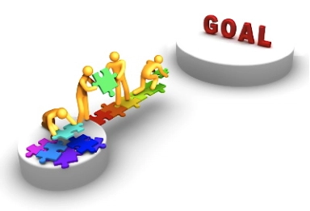
Aims and Objectives
By the end of this session, you should be able to:
Explain what a medical device is
State how medical devices and sharps are regulated
Purchase equipment correctly
Safely store devices
Use medical devices correctly
Handle sharps safely
Take appropriate action in the event of a sharps injury
Evaluate risk
Report faults correctly

Slide 3
What is a Medical Device?
A medical device is any product used in the:
• diagnosis, prevention, monitoring and treatment of disease or disability
Examples: diagnostic imaging scanners, needles, gloves, thermometers
• alleviation of or compensation for an injury or handicap
Examples: hearing aids, walking aids, wheelchairs, contact lenses
• investigation, replacement or modification of the anatomy, or of a physiological process
Examples: pacemakers, implants, ventilators
• control of conception.
Examples: condoms, IUD’s, pregnancy test kits

Slide 4
Who Regulates Medical Devices?
Principal aim is to safeguard the public’s health by:
Ensuring that medical devices work properly and are acceptably safe
Responding promptly when new things come to light; has power to withdraw products from the market. Can prosecute a manufacturer or distributor if the law has been broken

Slide 5
Regulation for Sharps
Health and Safety (Sharp Instruments in Healthcare) Regulations 2013
The main message from regulation;
Avoid unnecessary use of sharps
Use safer sharps (with protection mechanism) as a preferred option, unless unsafe or compromises patient care
Risk assessment for non-safety sharps

Slide 6
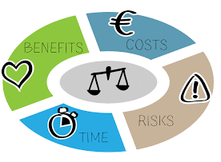
Purchase, Use and Storage
Purchasing Equipment
Sometimes purchased as part of ongoing replacement programme
May be purchased via the organisation or individual departments
Needs to be reviewed by relevant group and meet relevant standards (e.g. infection control, MHRA, standardisation)
Trial is organised if necessary
Training must be completed before use

Slide 7
Using equipment
Ten key factors to consider when using medical devices
Fit for purpose including consumables
Safety checked/ acceptance tested
EME label and service due sticker
Any visible damage
Clean
Correct power cable / accessories
Staff trained/ shown how to use
Patient aware of what the device does
Staff know what to do if the device fails
What to do with the device after use

Slide 8
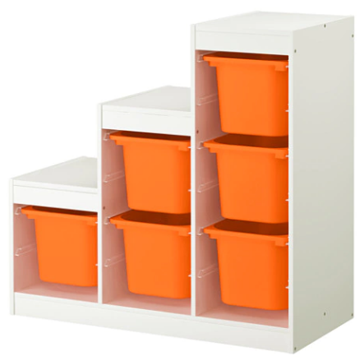
Storage of Equipment
Medical devices should be stored in a clean and safe environment
Some equipment is kept in the equipment library
Equipment on the ward should be kept in a designated storage area
Keep equipment clean and ready to use for the next person

Slide 9
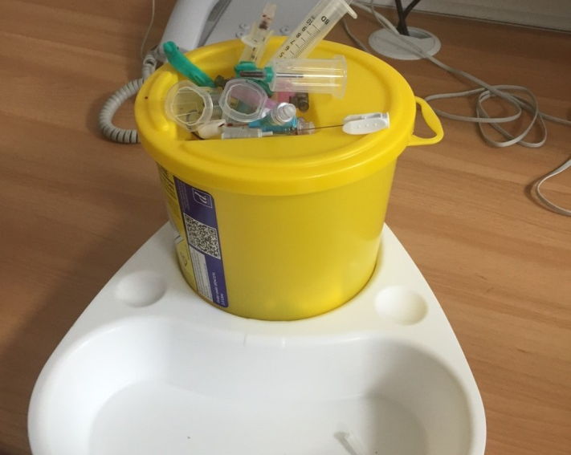
Safe Use and Disposal of Sharps
Choose safety-sharps in the first instance. A non-safety sharp can be used only where it is clearly the safer option.
Sharps must not be passed directly from hand to hand; handling should be kept to a minimum.
Needles must not be re-capped or bent, broken or disassembled at any point.
Sharps containers must not be used for any purpose other than the safe disposal of sharps.
Sharps must be disposed at the point of use into a sharps container. The person using the sharp is responsible for its safe disposal.
Sharps containers must be positioned safely & secured to prevent spillage.
Do not be fill above the fill line and use temporary closure when not in use.
Unsafe practice

Slide 10
In The Event of a Sharps Injury
Clean immediately with soap and water and encourage to bleed, dry and cover with dressing
Visit/ Inform occupational health straight away if possible (Mon- Fri 9-5) ext. 1631
Visit ED out of hours
Datix as soon as practicable

Slide 11
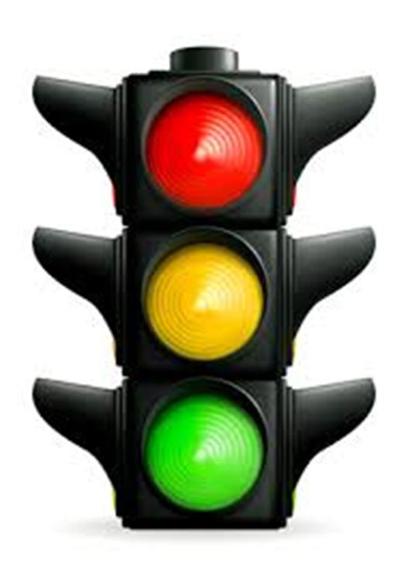
Risk Classification
High Risk Device
Where medical device failure or misuse is reasonable likely to seriously injure or kill a patient or staff – Competency Assessment Training is 3 yearly
Medium Risk
Where medical device failure, misuse or absence would have a significant impact on patient care but would not be likely to cause direct serious injury – Training session every 5 years
Low Risk
Medical devices where failure or misuse is unlikely to result in serious consequences – Training is once only on induction or introduction of new equipment

Slide 12
Risk Classification
 | Likelihood of something going wrong with incorrect use
Consequence | 1 Rare | 2 Unlikely | 3 Possible | 4 Likely | 5 Almost Certain
1 Negligible | 1 | 2 | 3 | 4 | 5
2 Minor | 2 | 4 | 6 | 8 | 10
3 Moderate | 3 | 6 | 9 | 12 | 15
4 Major | 4 | 8 | 12 | 16 | 20
5 Catastrophic | 5 | 10 | 15 | 20 | 25

Slide 13
Reporting Faults
If a piece of equipment appears to be faulty, certain processes should be followed
Take it out of use and segregate it
Place a completed red tag from the EME department
Include any details about error code or any message that was displayed on the machine if applicable
Put it at the designated point of collection by the equipment library or take it to the equipment library to be booked in for repair

Slide 14
Summary
Remember, to ensure medical devices meet the needs of patients they should be
Appropriate for desired outcomes
Only used after appropriate training has been received
Monitored while being used and action taken if they do not appear to be working correctly
Routinely maintained in line with manufacturer recommendations
Repaired when necessary
Click here for the SASH policy on medical devices management

