Slide 1
ECG Masterclass
How to understand ECGs, instead of just learning them by rote
Notes:
These lectures assume no prior knowledge of ECG interpretation
Where possible, I try to explain why ECG patterns appear as they do
(But, sadly, this is not always possible…)
I won’t focus on management of pathologies, only physiology & interpretation

Slide 2
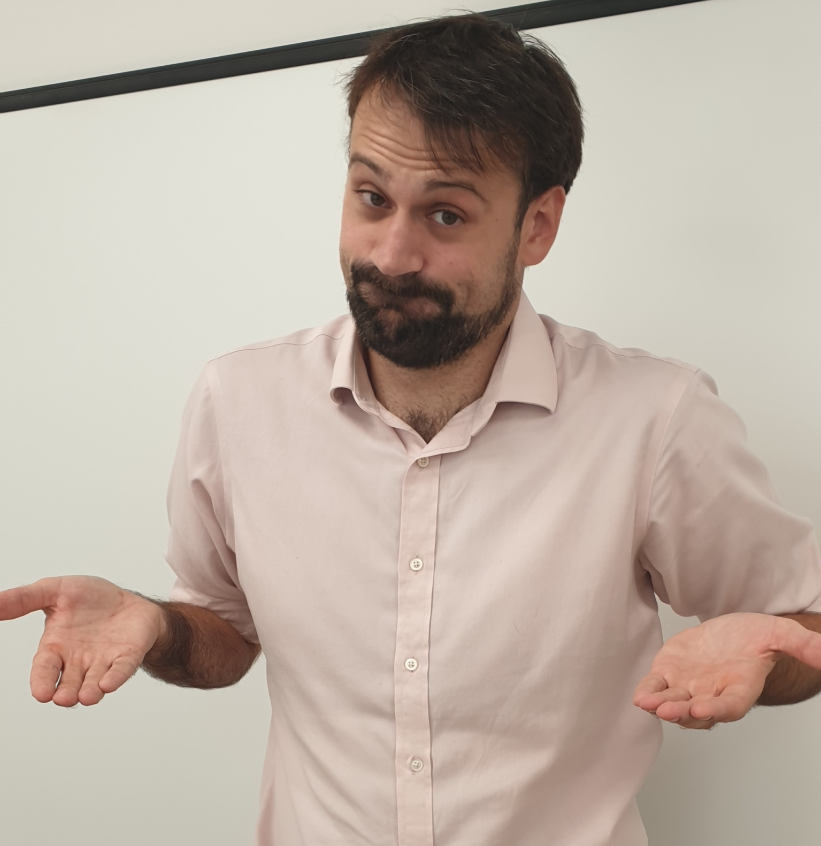
Notes:
When I can’t really explain something well, this will show up…

Slide 3
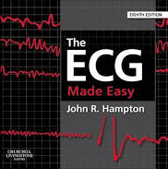
95% of the information in these slides comes from these two textbooks:
(which I don’t recommend)
(which I heartily recommend)
“The ECG Made Easy”, John R. Hampton, Eighth Edition, Elsevier Ltd 2013, front cover
“The Only EKG Book You’ll Ever Need”, Malcolm S. Thaler, Eighth Edition, Wolters Kluwer Health, 2014, front cover

Slide 4
Lecture 1: why do ECGs look like they do? part 1
2: why do ECGs look like they do? part 2
3: heart block
4: hypertrophy
5: arrhythmias, part 1
6: arrythmias, part 2
7: infarction, ischaemia and inflammation
8: wrapping it all up

Slide 5
Lecture 1
Why do ECGs look like they do?
Part 1 – QRS complexes

Slide 6
QRS complex: ventricular depolarisation
P-wave: atrial depolarisation
T-wave: ventricular repolarisation
https://www.karingalvet.com.au/our-services/diagnostic-care/electrocardiography/
Notes:
Remember our first positive deflection is termed our R-wave
An S-wave is a negative deflection that follows an R-wave; a Q-wave precedes it

Slide 7
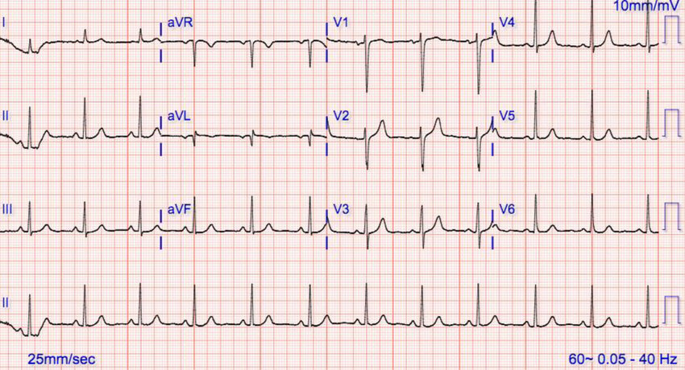
https://www.researchgate.net/figure/Repeat-12-lead-EKG-showing-normal-sinus-rhythm_fig2_322504203

Slide 8
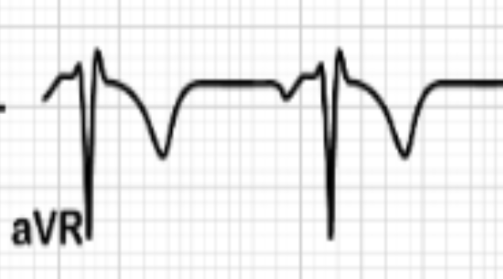
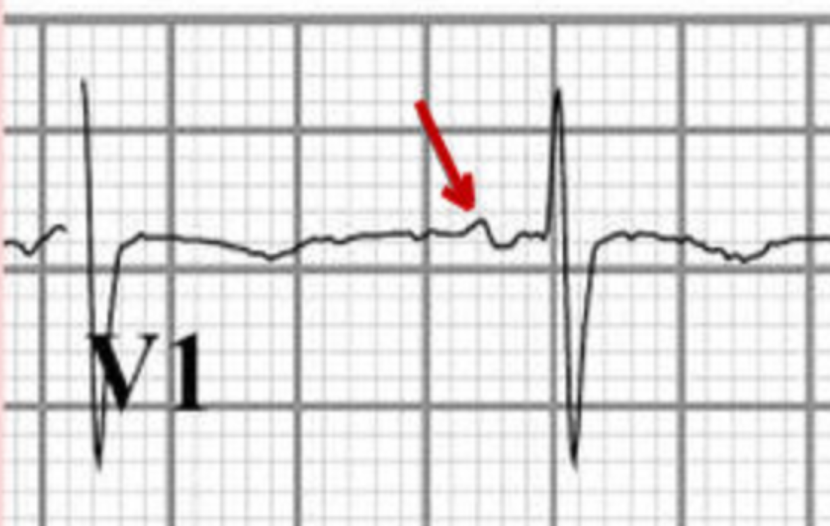
https://codeoneapp.com/2018/07/11/unipolar-bipolar-ecg/
https://www.wikidoc.org/index.php/File:NormalSR.jpg

Slide 9
depolarisation
+
ECG pad
ECG trace

Slide 10
depolarisation
+
ECG pad

Slide 11
+
ECG pad

Slide 12
+
ECG pad

Slide 13
+
ECG pad

Slide 14
depolarisation
+
ECG pad

Slide 15
+
ECG pad

Slide 16
+
ECG pad

Slide 17
repolarisation
+
ECG pad
ECG trace

Slide 18
+
ECG pad

Slide 19
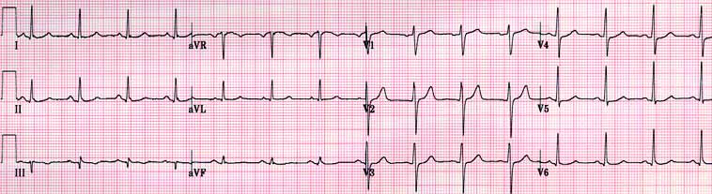
http://www.imperialendo.co.uk/Newskills/ecg/index.html
Limb leads
Chest leads

Slide 20
Limb leads
Chest leads
Earth
https://www.pinterest.com/pin/268879040231161313/

Slide 21
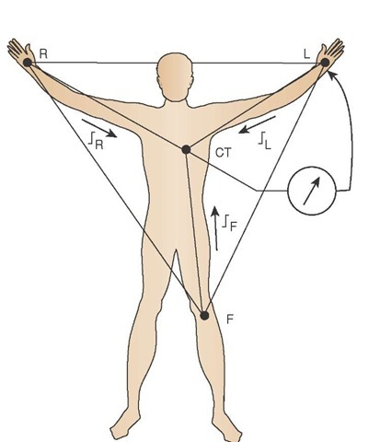
Wilson’s central terminal
http://what-when-how.com/paramedic-care/diagnostic-ecgthe-12-lead-clinical-essentials-paramedic-care-part-1/

Slide 22
The QRS complex

Slide 23
Chest leads
https://www.pinterest.com/pin/268879040231161313/

Slide 24
“The ECG Made Easy”, John R. Hampton, Eighth Edition, Elsevier Ltd 2013, pg 11

Slide 25
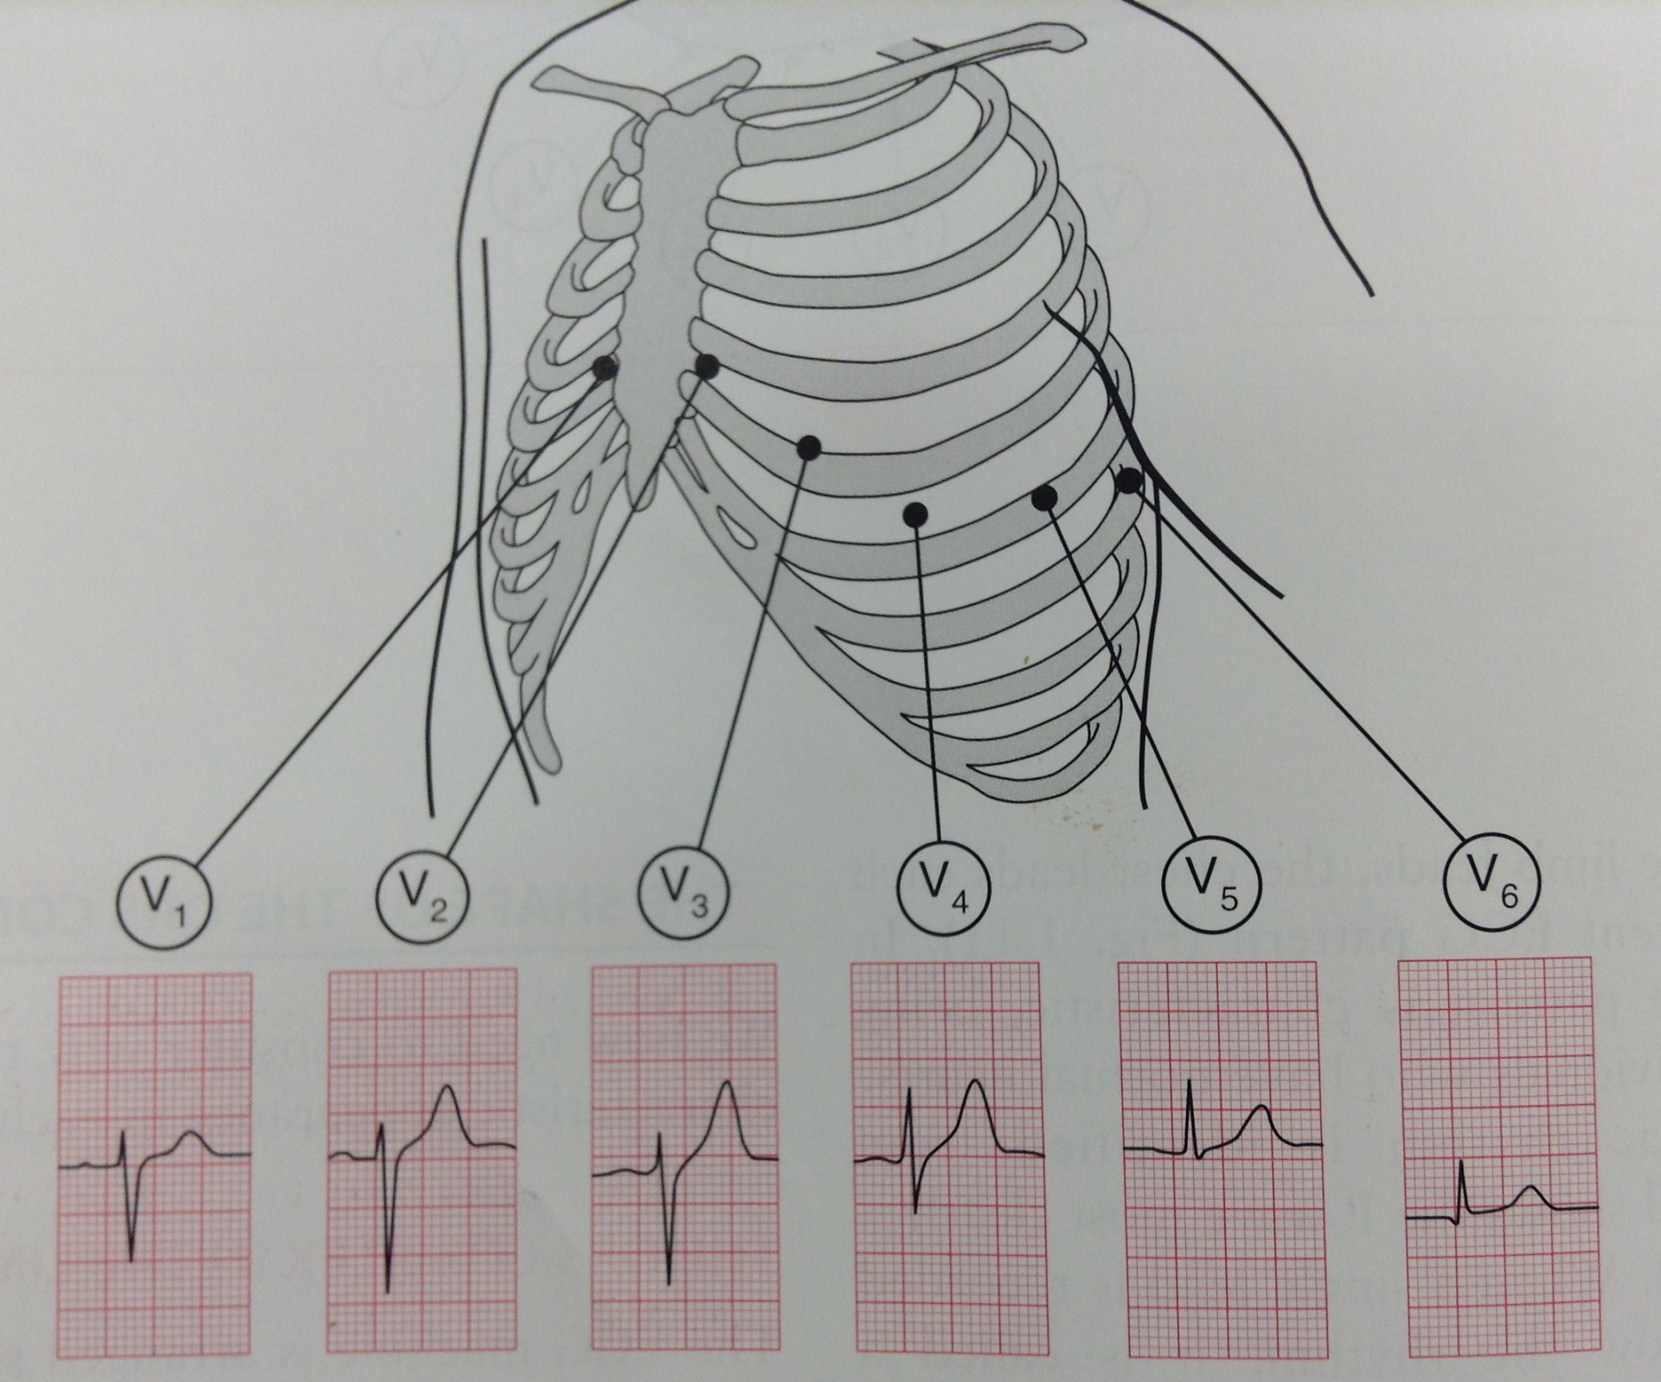
“The ECG Made Easy”, John R. Hampton, Eighth Edition, Elsevier Ltd 2013, pg 12
S > R
R > S
S = R

Slide 26
The shape of the QRS complex in the chest leads is determined by two factors:
The left ventricle is much bulkier than the right, so more current passes through it
The interventricular septum is depolarised before the ventricles, from left to right

Slide 27
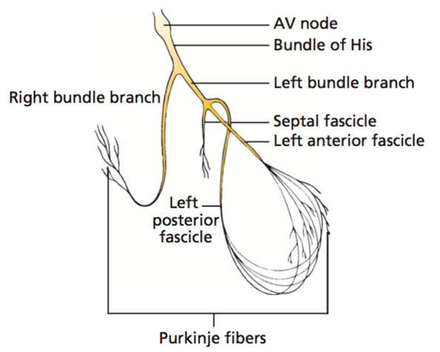
The septal fascicle is part of the left bundle branch
Depolarises the septum
R
L
Points from left to right
“The Only EKG Book You’ll Ever Need”, Malcolm S. Thaler, Eighth Edition, Wolters Kluwer Health, 2014, pg 188

Slide 28
First stage
“The ECG Made Easy”, John R. Hampton, Eighth Edition, Elsevier Ltd 2013, pg 17
Notes:
After the AVN, the depolarisation spreads into the septum
The first thing that happens is that the septum is depolarised via the septal fascicle
As the septal fascicle points from left to right, the depolarisation heads towards the right ventricle
So electrodes that measure the right ventricle (V1 & 2) will show a positive deflection (R-wave)
Whilst electrodes that measure the left ventricle (V5 & 6) will show a negative deflection (Q-wave)

Slide 29
Second stage
“The ECG Made Easy”, John R. Hampton, Eighth Edition, Elsevier Ltd 2013, pg 17
Notes:
Next, the depolarisation reaches the apex and spreads into the ventricles
Because the left ventricle is larger than the right, more current spreads into it
Thus, the ECG trace is weighted towards the left ventricle
So there is a large positive deflection (R-wave) in the LV electrodes (V5 & 6)
And a large negative deflection (S-wave) in the RV electrodes (V1 & 2)
The ECG trace will return to baseline once the whole myocardium has been depolarised

Slide 30
“The ECG Made Easy”, John . Hampton, Eighth Edition, Elsevier Ltd 2013, pg 12
R-wave progression
transition
point
Notes:
So, at V1, we have a small R-wave
Whilst at V5 & 6, we have large R-waves
This gradual increase in R-wave size is known as the R-wave progression
Not only does the R-wave grow from V1 to 6, the S-wave shrinks
The transition point is the point where the S-wave is (roughly) equal to the R-wave
The transition point reflects the approximate site of the septum
It is usually found at V3 or 4

Slide 31
Limb leads

Slide 32
Earth
https://www.pinterest.com/pin/268879040231161313/
Notes:
Some of the limb leads are composite or augmented leads (aVF, aVR and aVL)

Slide 33
http://www.imperialendo.co.uk/Newskills/ecg/index.html
Limb leads
Chest leads

Slide 34
https://en.wikipedia.org/wiki/Einthoven%27s_triangle

Slide 35
Head
The limb leads visualise the heart in a coronal/top-bottom plane
R
L
aVR visualises the right atrium
II, III and aVF: the inferior heart border
I, II and aVL: the left lateral border
Feet
“The ECG Made Easy”, John R. Hampton, Eighth Edition, Elsevier Ltd 2013, pg 10

Slide 36
Head
R
L
aVR
R = right
aVL
L = left
120˚
aVF
F = feet
Feet

Slide 37
Head
R
L
aVR
R = right
aVL
L = left
120˚
I
30˚
III
aVF
F = feet
II
Feet

Slide 38
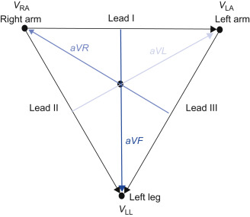
https://www.sciencedirect.com/topics/nursing-and-health-professions/electrocardiographic-lead

Slide 39
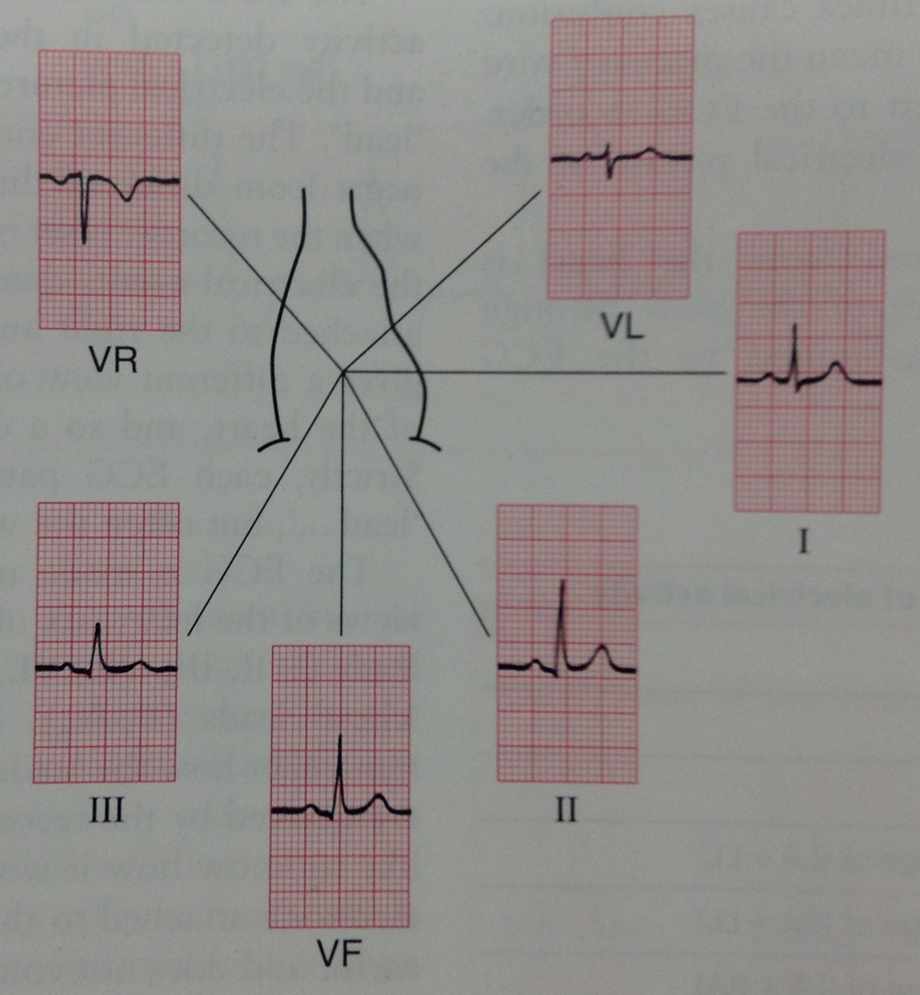
Cardiac axis
“The ECG Made Easy”, John R. Hampton, Eighth Edition, Elsevier Ltd 2013, pg 10
“The Only EKG Book You’ll Ever Need”, Malcolm S. Thaler, Eighth Edition, Wolters Kluwer Health, 2014, pg 188
Notes:
To understand the shape of the QRS complexes in the limb leads, we need to understand about cardiac axis
The cardiac axis represents the net direction of the wave of depolarisation during each heartbeat in this coronal plane

Slide 40
“The ECG Made Easy”, John R. Hampton, Eighth Edition, Elsevier Ltd 2013, pg 10
Notes:
So, the shape of the QRS complexes corresponds to the position of the leads in relation to the axis
II and aVF have big, positive R-waves because they measure the inferior heart border, where the axis points
I and III have smaller R-waves because overall, the axis moves towards them but at an acute angle
aVR has a big, negative S-wave as the axis moves away from it
aVL has equal R and S-waves as the axis is perpendicular to it

Slide 41
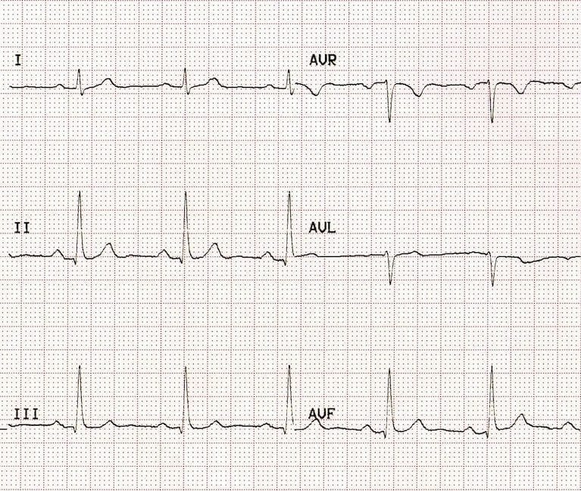
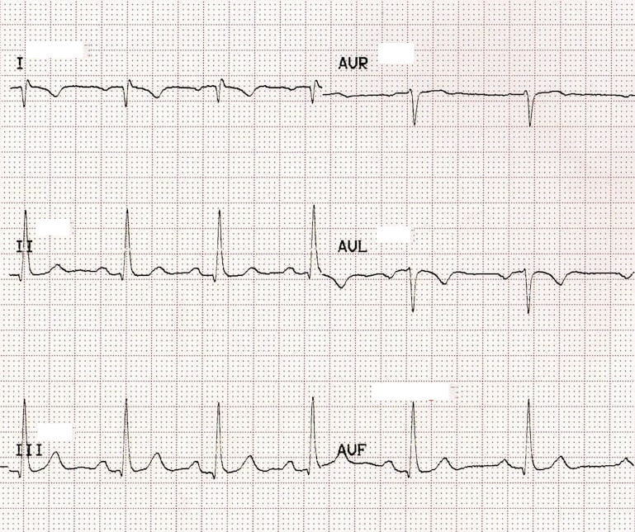
https://litfl.com/ecg-limb-lead-reversal-ecg-library/
https://litfl.com/ecg-limb-lead-reversal-ecg-library/

Slide 42
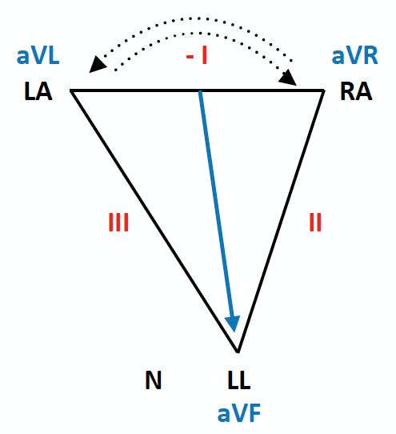
“The ECG Made Easy”, John R. Hampton, Eighth Edition, Elsevier Ltd 2013, pg 10
https://litfl.com/ecg-limb-lead-reversal-ecg-library/

Slide 43
So that’s why the QRS complexes look like they do!
chest leads: two factors (big bulky LV and septal fascicle)
limb leads: learn the cardiac axis model
Any questions?
Feedback please! www.surveymonkey.co.uk/r/29Z3VF5

