Slide 1
Prescribing Course
SESSION 1
Prescribing Teaching
Max Roberts
max.roberts@nhs.net

Slide 2
Objectives
The basics
Basics of prescribing
Brief overview of the PSA
Safe prescribing of some common medications
Cases

Slide 3
The Common Things
Common things
Drugs you may initiate
Antibiotics
VTE prophylaxis
Anti-hypertensives
Analgesia
Laxatives
Antiemetics
Blood products
Fluids
Drugs patients are commonly on
Anti-hypertensives | ACEi: Ramipril, Enalapril ARB: Losartan, Candesartan CCB: Amlodipine
Statins | Simvastatin, Atorvastatin
Diuretics | Furosemide, Bumetanide Bendroflumethiazide
Inhalers | Salbutamol, ipratropium Fostair (beclometasone ICS & formoterol LABA) Seretide (fluticasone ICS & salmetarol LABA)
Beta blockers | Bisoprolol, atenolol
Type 2 diabetes | Metformin, sitagliptin, gliclazide
Insulin | Slow: Glargine (Lantus), Detemir (Levemir), Tresiba (Degludec) Intermediate: Humilin Rapid: Aspart (Novorapid), Lispro (Humalog) Mixed insulins
Other | Anti-epileptics, anti-coagulants, anti-depressants, finasteride/tamsulosin, laxatives

Slide 4
The basics
The basics
All drugs
Drug name, dose, route, quantity, time, signature & name, bleep no.
Paracetamol
1g
Dr Pain
PO
xx/xx
Antibiotics – add duration, indication and review/stop date
Co-amoxiclav
1.2g
IV
10 days
xx/xx Dr Pen
xx+2/xx
xx+2/xx
PRN – add maximum frequency, indications
xx/xx
123
14
Early HAP

Slide 5
Funny Times
Funny times…
Morning | Night | Weekly
Levothyroxine | Senna | Methotrexate
Steroids | Statins | Alendronic acid (mane)
 | ACE inhibitors | Buprenorphine patch
Do | Don’t
Units | U
Micrograms | mcg
Strict timings
Levodopa
Notes:
Night: senna – takes 12hrs to work
ACEi – postural drop
Statins – HMG CoA reductase most active at night
Morning – steroids: insomnia
Levothyroxine – best on an empty stomach
Levodopa
Madopar (co-beneldopa): L-dopa + benserazide (peripheral DOPA decarboxylase inhibitor)
Sinemet (co-careldopa): L-dopa + careldopa

Slide 6
Consider the systems
System complications
Cytochrome P450
Renal
ACE and ARBs
Metformin
NSAIDs
Aminoglycosides (e.g. Gentamicin)
Lithium
Allopurinol
Digoxin
Methotrexate
Morphine
Warfarin + inhibitors
Increased [warfarin] - > raised INR
Warfarin + inducers
Decreased [warfarin] -> lower INR
Considerations:
Nephrotoxic drugs
Renally excreted drugs -> poor renal function = increased/toxic concentrations
Considerations:
Warfarin and P450 inhibitors/inducers?
Altering drug doses depending on patient pre-existing inhibiting/inducing medications
Notes:
Inducers PCBRAS
Phenytoin
Carbamazepine
Barbiturates (phenobarbital)
Rifampicin
Alcohol (chronic)
Sulphonylureas
+ St John’s wort
(Griseofulvin) Inhibitors AODEVICES
Allopurinol
Omeprazole
Disulfiram
Erythromycin
Valproate
Isoniazid
Ciprofloxacin
Alcohol (acute)
Sulphonamides (sulfamethoxazole: co-trimoaxole = trimethoprim + sulfamethoxazole)
+ ketoconazole/fluconazole, metronidazole, cimetidine
+ cranberry juice

Slide 7
Notes:
120/200 = 0.6 mins per mark = 36 secs per mark
10 marks/question = 6 mins/questions
4 marks/question = 2.4 mins/question = 2 mins 24secs / question
All else: 2 marks/question = 1.2 mins/question = 1min 12 secs / question

Slide 8
Given that you have 120 minutes for 200 marks. How many minutes do you have for a 2 mark question?
120/200 = 0.6mins/mark x2 = 1.2mins/2 marks (aka 72 seconds)
Notes:
120/200 = 0.6 mins per mark = 36 secs per mark
10 marks/question = 6 mins/questions
4 marks/question = 2.4 mins/question = 2 mins 24secs / question
All else: 2 marks/question = 1.2 mins/question = 1min 12 secs / question

Slide 9
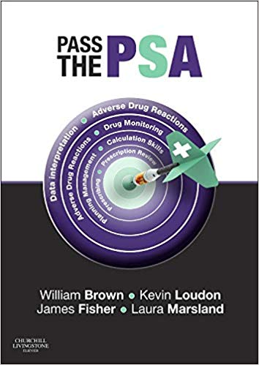
https://www.amazon.co.uk/Pass-Will-Brown-MBBS-MRCP/dp/0702055182

Slide 10
An unusual case

Slide 11
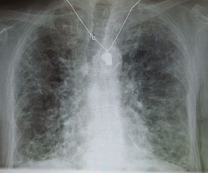
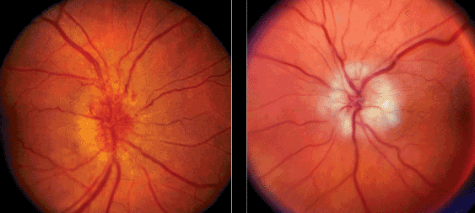
Amiodarone
https://www.medicinenet.com/image-collection/amiodarone_picture/picture.htm
https://webeye.ophth.uiowa.edu/eyeforum/atlas/pages/Verticillata/index.htm
https://en.wikipedia.org/wiki/Amiodarone
TSH | T3 | T4
https://www.reviewofophthalmology.com/article/diagnosing-and-managing-ischemic-optic-neuropathy
Notes:
Side effects of amiodarone:
Blue-grey skin
Corneal deposits
Pulmonary fibrosis
Thyroid disorders (hypo- or hyperthyroidism) – hypothyroidism more common
Optic neuropathy
Gynaecomastia
Epididymitis
Class III anti-dysrhythmic: prolongs phase 3 of the cardiac action potential, the repolarization phase where there is normally decreased calcium permeability and increased potassium permeability

Slide 12
Amiodarone
Indications | Arrhythmias (SVT, VT, AF and flutter, VF, Wolff-Parkinson-White syndrome)
Monitoring | BEFORE: CXR, TSH/T4/T3, LFTs EVERY 6 months: LFTs, TFTs
Side effects | Constipation, corneal deposits, thyroid disorders (hypo- or hyper-), peripheral neuropathy, metallic taste, blue-grey skin Hepatotoxicity, Hyperthyroidism/hypothyroidism, Pneumonitis/pulmonary fibrosis, corneal deposits/optic neuritis
Contraindications | Conduction disorders, AV block, iodine sensitivity, thyroid dysfunction, bradycardias
https://www.pinterest.co.uk/pin/374291419013265639/?lp=true
Notes:
Careful in hypokalaemia as it can precipitate arrhythmias (counter-intuitively!)

Slide 13
Prescribe a loading regimen of oral amiodarone for a patient with paroxysmal SVT

Slide 14
Amiodarone
Date Time
1
2
3
4
5
6
7
8
9
10 11 12 13 14 15 16 17 18 19 20
Drug
6
Amiodarone
8
Signature. Loading
Dose 200mg Prescriber
Route
PO
12
dose amiodar rone
Doctor
14
Bleep
Start date
xx/xx/xx
Pharmacy
18
1234
Notes
22
Additional information Drug
200mg TDS for 7 days, then 200mg BD for 7 days, then 200mg OD thereafter.
6
Amiodarone
8
Dose 200mg Prescriber
Route
PO
12
Doctor
14
Bleep
Start date xx+7/xx/xx Pharmacy
18
1234
Notes
22
Additional information 200mg BD for 7 days, then 200mg OD thereafter.
OR….

Slide 15
Amiodarone
 |  | Date |  | 1 | 2 | 3 | 4 | 5 | 6 | 7 | 8 | 9 | 10 | 11 | 12 | 13 | 14 | 15 | 16 | 17 | 18 | 19 | 20
 |  | Time
Drug Amiodarone |  | 6
 |  | 8
Dose 200mg | Route PO | 12
Prescriber Doctor |  | 14
Bleep 1234 | Start date xx/xx/xx | 18
Notes | Pharmacy | 22
Additional information 200mg TDS for 7 days, the 200mg BD for 7 days, then 200mg OD thereafter.

Slide 16
Cases

Slide 17
Case 1
Nigel Notreal MRN: 1234567. DOB: 1/1/1959.
Nigel Notreal is admitted with acute LV failure with gross pulmonary oedema. Your registrar has prescribed IV furosemide and Nigel’s regular prescriptions but asks you to complete his VTE assessment and prescribe accordingly.
PMH: BPH, CCF, Osteoarthritis, Diabetes, Varicose veins. 80kg
NKDA.
DH: Tamsulosin, Furosemide 40mg OD, Paracetamol, Metformin 1g BD
Bloods: Na 132, BNP 500, otherwise NAD; Obs: SpO2 94% on 15L/min, BP 110/70; BMI 23.4
Please prescribe VTE prophylaxis, if appropriate, based on the risk assessment
Contraindications to Graduated Compression Stockings
Acute stroke
Gross leg or pulmonary oedema
Local leg conditions such as gangrene, dermatitis, skin grafts
Extreme deformity of the leg or unusual leg shape/size
Peripheral vascular disease with no palpable pedal pulses
Arterial bypass grafting
Known allergy to material of manufacture

Slide 18
Case 1
Nigel Notreal MRN: 01234567 DOB: 1/1/1959.
Nigel Notreal is admitted with acute LV failure with gross pulmonary oedema.
PMH: BPH, CCF, Osteoarthritis, Diabetes, Varicose veins. 80kg
NKDA
DH: Tamsulosin, Furosemide 40mg OD, Paracetamol, Metformin 1g BD
Bloods: Na 132, BNP 500, otherwise NAD; Obs: SpO2 94% on 15L/min, BP 110/70, otherwise normal; BMI 23.4
Enoxaparin
40mg Doctor
SC
xx/xx
But different trusts will use different LMW heparins
Please prescribe VTE prophylaxis, if appropriate.

Slide 19
Case 2
Digoxin
62.5mg OD
xx/xx
You are on-call on ward cover and are asked to rewrite a drug chart for Judie Doe, 88-year-old woman, who was admitted 1 month ago with a UTI. She had 4 days of diarrhoea. Stool cultures were negative and she has opened her bowels 3 times today.
PMH: Hypertension, constipation, Type 2 DM, AF, OA, CKD
NKDA.
On examination
Observations: HR 99, BP 100/64, 37 C, RR 18, SpO2 95%.
Chest is clear, Abdomen is soft and non tender. Dry mucus membranes. JVP not raised. DRE: Empty Rectum. Weight 60kg
Investigations
Bloods today: WCC 10.3, Hb 121, K 3.5, Na 142, Urea 7, Creatinine
152 (up from 100), eGFR 23 (down from 43), CRP 10
Ramipril
5mg OD PO
Doctor 123 xx/xx
Metformin
1g BD PO
Doctor 123 xx/xx
Ibuprofen
400mg TDS PO
Doctor 123 xx/xx
Senna
15mg OD PO
Doctor 123 xx/xx
Prescribing request
1. Please rewrite the drug chart.

Slide 20
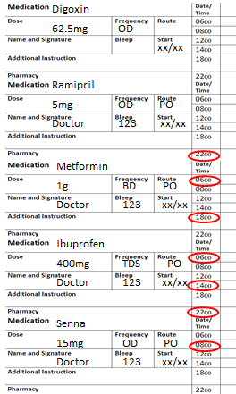
Case 2
You are on-call on ward cover and are asked to rewrite a drug chart for Judie Doe, 88-year-old woman, who was admitted 1 month ago with a UTI. She had 4 days of diarrhoea. Stool cultures were negative and she has opened her bowels 3 times today.
PMH: Hypertension, Constipation, Type 2 DM, AF, OA, CKD
NKDA.
On examination
Observations: HR 99, BP 100/64, 37 C, RR 18, S:95%.
Chest is clear, Abdomen is soft and non tender. Dry mucus membranes. JVP not raised. DRE: Empty Rectum. Weight 60kg
Investigations
Bloods today: WCC 10.3, Hb 121, K 3.5, Na 142, Urea 7, Creatinine 152 (up from 100), eGFR 23 (down from 43), CRP 10
Digoxin 62.5 micrograms PO + ensure route, timings & signature filled in
Hold Ramipril (cross off 3-5 days followed by r/v). BP is low and patient has an AKI.
Hold Metformin (eGFR <30)
Ibuprofen – stop (AKI on CKD, elderly)
Start paracetamol as alternative analgesia for OA
Senna 15mg PO ON (hold – patient has diarrhoea; PRN, or stop for GP to review)
1. Please rewrite the drug chart.
Notes:
Metformin can lead to lactic acidosis in renal impairment
Metformin acts to increase sensitivity to insulin and also to reduce hepatic gluconeogenesis: this usually takes up lactate in the process → hence why inhibiting it can lead to lactic acidosis, especially in the context of renal impairment

Slide 21
Case 2
Ramipril
5mg ON PO
Doctor 123 xx/xx
Paracetamol
1g QDS PO
Doctor 123 xx/xx
r/v
Digoxin
62.5 micrograms OD PO
Doctor 123 xx/xx
Metformin
1g BD PO
Doctor 123 xx/xx
r/v
r/v
Senna - PRN or stopped for GP to review

Slide 22
Case 2
3 days later…
You are asked to review the blood results for the same patient.
She has still been having diarrhoea but has been receiving IV fluid.
Investigations
Bloods today: WCC 9.8, Hb 118, K 3, Na 142, Urea 4.9, creatinine 112 (down from 152), eGFR 35 (down from 23), CRP 4
Date | Infusion Solution | Drugs and Dose to be added | Total Volume | Route | Rate | Signature, GMC, Bleep
xx/xx | 0.9% sodium chloride | 40mmol potassium chloride | 1L | IV | 6 hours | Doctor 123
10mmol of KCl = ~0.15 [K+]
2. As the patient is hypokaelamic, please prescribe appropriate fluid replacement

Slide 23
Summary
Basics of safe, accurate prescribing
Amiodarone
VTE prophylaxis – every patient needs to be assessed
Drug interactions – P450 inducers/inhibitors
Considerations in renal impairment – withold/stop nephrotoxics
“Rewriting drug charts” is actually reviewing and writing up an appropriate new drug
chart

Slide 24
Thank you!
Please don’t forget to complete the feedback:
www.surveymonkey.co.uk/r/29Z3VF5
Any questions?

