Slide 1
Prescribing Teaching
Prescribing Session 6
Max Roberts
max.roberts@nhs.net

Slide 2
Overview
Sign-offs!
Gentamicin
Hypoglycaemia

Slide 3
Gentamicin

Slide 4
Gentamicin
Tell me some things about gentamicin!
aminoglycoside antibiotic (alongside amikacin, tobramycin, neomycin, streptomycin)
used mainly for Gram-negative infections
renally cleared
can’t give orally
used for urinary infections/pyelonephritis, meningitis, PID, endocarditis, neutropoenic sepsis, biliary tract infection, pneumonia, bone/joint infections, eye/ear infections
main SEs: nephrotoxicity, ototoxicity (also be careful in myasthenia gravis)
Gentamicin is a super-effective antibiotic but it is dangerous – if used improperly
Notes:
Works by binding the 30S subunit of the bacterial ribosome, negatively impacting protein synthesis
Gent interferes with your nicotinic acetylcholinergic receptors in your post-synaptic membrane

Slide 5
Gentamicin
Your registrar asks you to prescribe a ‘once-daily’ IV gentamicin regimen for a male patient admitted with acute pyelonephritis – and then leaves before you can ask any questions. The time is 6pm in the evening, and you are due to finish at 8pm.
Name: Mark Jones
DOB: 1/8/1949
MRN: 1234567
Height: 185cm, weight: 80kg, creatinine: 110μmol/L
Please prescribe the first dose.
What will you hand over to the night FY1?
Notes:
Works by binding the 30S subunit of the bacterial ribosome, negatively impacting protein synthesis

Slide 6
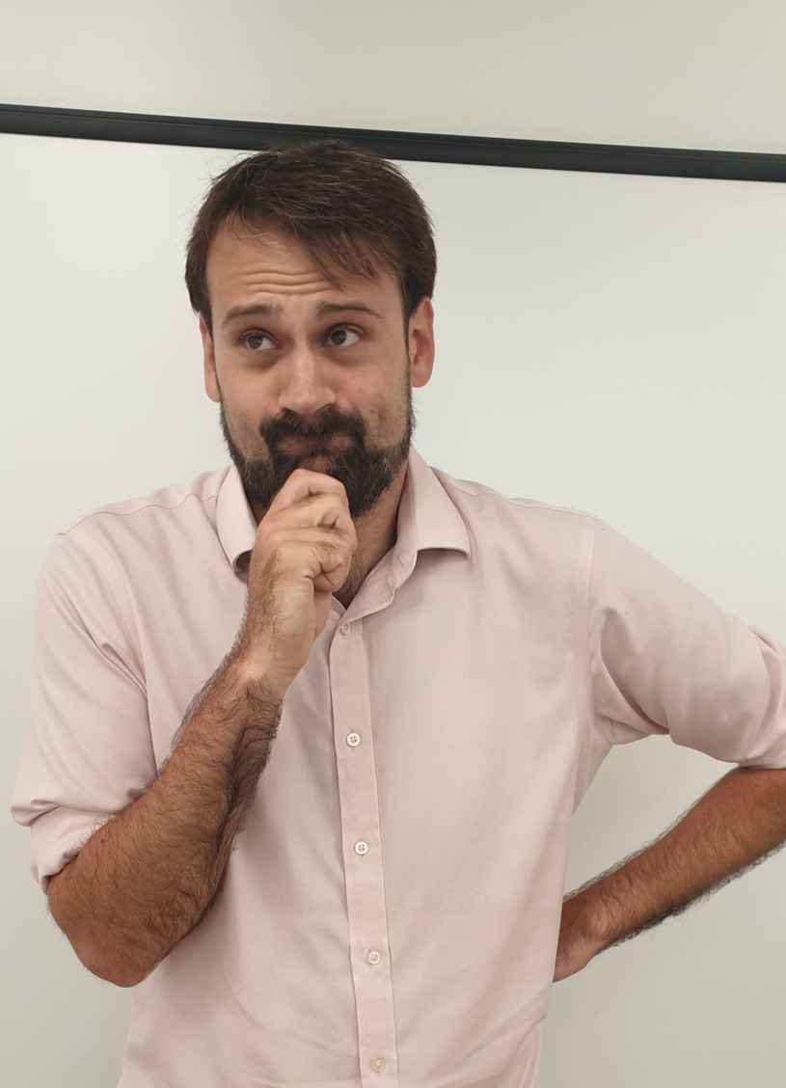
Anyone confused?

Slide 7
Gentamicin
Most patients on IV gentamicin will receive either:
- high-dose ‘once daily’ regime of 5-7 mg/kg
- or a ‘divided daily dosing’ regime of 1-2.5 mg/kg, if they have endocarditis or creatinine clearance <20 ml/min
However, best to avoid giving gentamicin in renal failure
We can also give once-off doses, e.g. in urinary catheter changes or surgical prophylaxis
Notes:
Works by binding the 30S subunit of the bacterial ribosome, negatively impacting protein synthesis

Slide 8
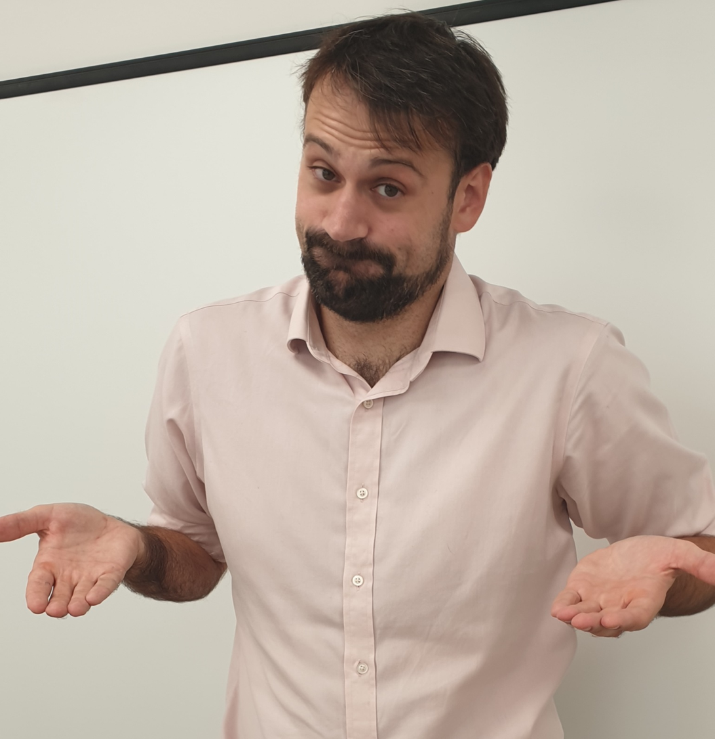
Anyone still confused?

Slide 9
Gentamicin
So let’s break it down.
Most patients will be on a ‘once-daily’ dosing regime, and there are three main things we need to know for this:
Do we prescribe 5 mg/kg or 7 mg/kg?
Is the patient obese?
Creatinine clearance (not eGFR)
Hospital policy
Notes:
eGFR is less accurate than CrCl – but CrCl uses weight, which is not routinely available to the lab

Slide 10
Gentamicin
For gentamicin calculations, we use ideal body weight to determine if a patient is obese
Ideal body weight (IBW) is based on patient height:
Females = 45.5kg + (2.3 x every inch over 5ft)
Males = 50kg + (2.3 x every inch over 5ft)

Slide 12
Let’s say we have a female patient who is 183cm tall – what’s the IBW?
Here is where it gets annoying: we now need to work out if the patient is obese
Multiply the ideal body weight (IBW) by 1.2
e.g. 73.1kg x 1.2 = 87.7kg
If the actual body weight (ABW) is less than/equal to this number (say, 80kg), the patient is not obese, so we use their ABW to determine the dose
e.g. 80kg at 7 mg/kg = 560mg
If the actual body weight is greater than this number (say, 100kg), then the patient is obese, and we use Corrected Dosing Weight (CDW):
CDW = IBW + 0.4 (ABW-IBW)
73.1kg + 0.4 (100kg – 73.1kg) = 83.9kg
83.9kg at 7 mg/kg = 587mg
http://www.microguide.eu/
Notes:
In the absence of BMI calculations, obesity can be defined as a patient being greater than 20% above their ideal body weight
Gentamicin is not absorbed into adipose tissue so we run the risk of overdosing obese patients otherwise
Corrected dosing weight is also known as adjusted body weight

Slide 13
corrected dosing weight calculator

Slide 14
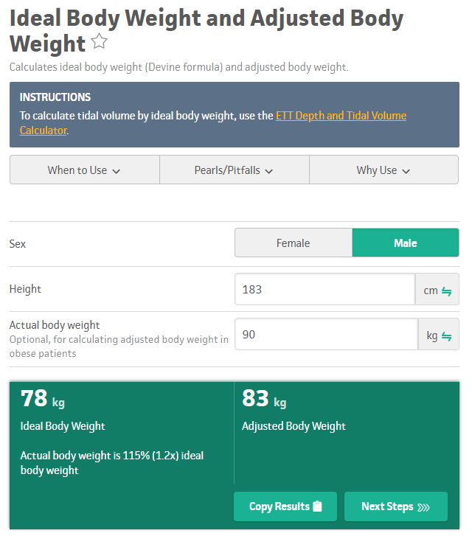
https://www.mdcalc.com/ideal-body-weight-adjusted-body-weight

Slide 15
So, confusingly and annoyingly, we don’t actually use ideal body weight to calculate the dose
We use ideal body weight to work out if they are obese or not
We then either use actual body weight if the patient is not obese
Or corrected dosing weight if they are

Slide 16
Gentamicin
We tend to round to the nearest 40mg
So 587kg would be rounded up to 600mg
This trust has a maximum dose of 480mg; others have a max dose of 600mg
Notes:
Works by binding the 30S subunit of the bacterial ribosome, negatively impacting protein synthesis

Slide 17
Gentamicin
Do we prescribe 5 mg/kg or 7 mg/kg?
Is the patient obese?
Creatinine clearance (not eGFR)
Hospital policy
Notes:
Works by binding the 30S subunit of the bacterial ribosome, negatively impacting protein synthesis

Slide 18
https://www.aerzteblatt.de/int/archive/article/174774/Renal-insufficiency-and-medication-in-nursing-home-residents-a-cross-sectional-study-(IMREN)
S_{Cr} = serum creatinine
We use actual body weight (ABW)…
…unless the patient is obese (ABW > IBW x 1.2)…
…in which case, use IBW (not CDW)

Slide 19
https://giphy.com/gifs/filmeditor-home-alone-christmas-movies-3ohA2ZD9EkeK2AyfdK

Slide 21
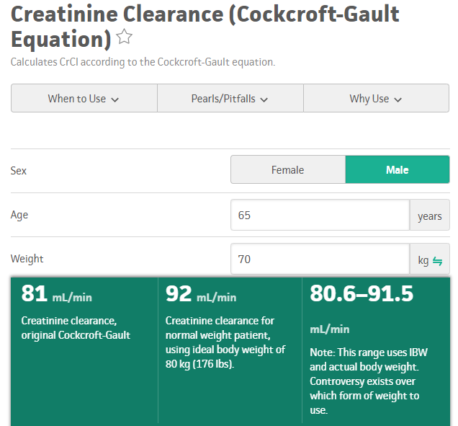
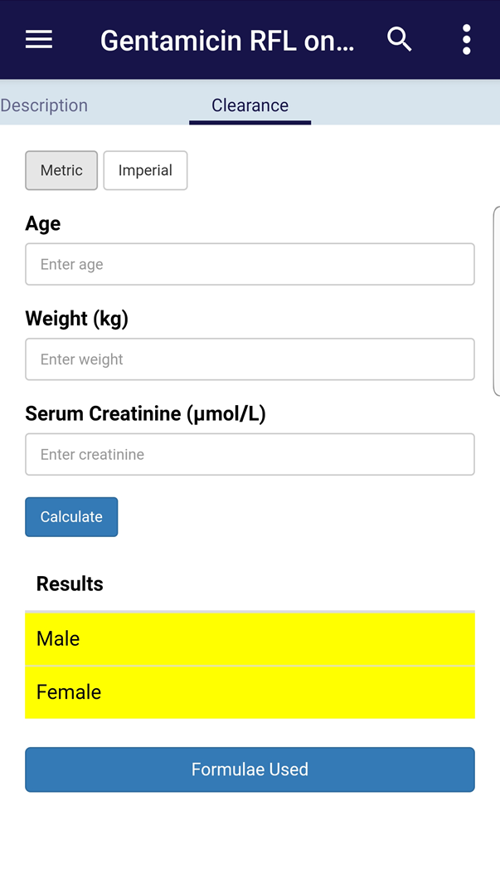
https://www.mdcalc.com/creatinine-clearance-cockcroft-gault-equation
http://www.microguide.eu/

Slide 22
Gentamicin
If CrCl <20 ml/min:
- use a divided dosing regime (more on that in a sec)
- use a different antibiotic!
If CrCl >60 ml/min, go ahead and use at your trust-approved dose (e.g 5 mg/kg, once daily)
With CrCl between 20-60 ml/min, different trusts will either:
- reduce the dose slightly (5 mg/kg → 3 mg/kg)
- or lengthen the dosing interval (5 mg/kg, every 36hrs)

Slide 23
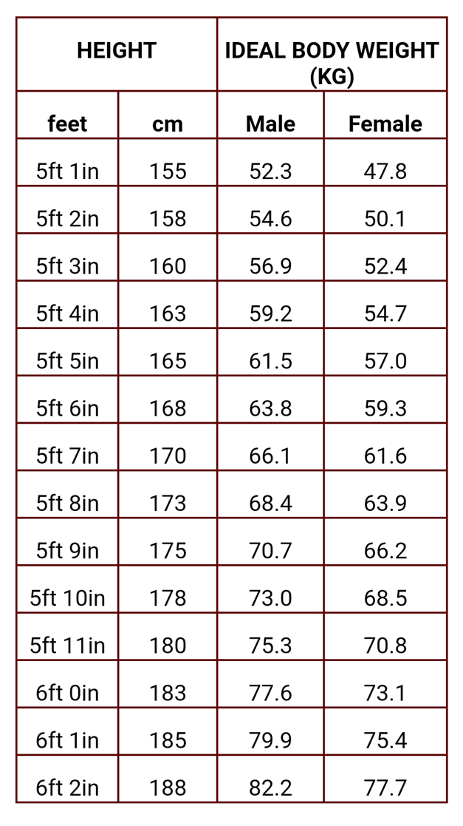
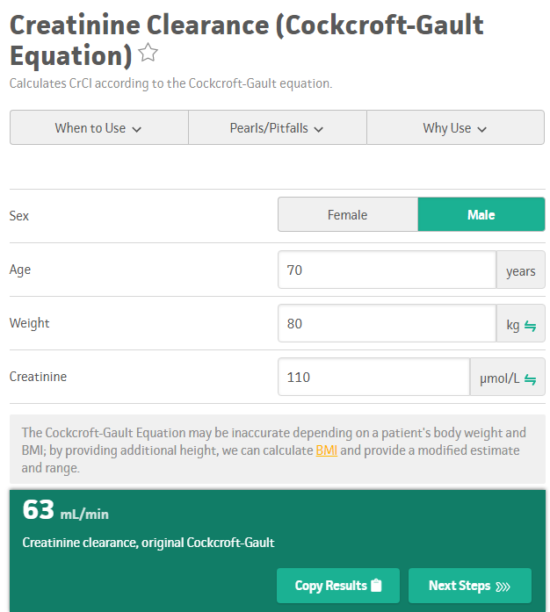
Gentamicin
Name: Mark Jones
DOB: 1/8/1949
MRN: 1234567
Height: 185cm, weight: 80kg, creatinine: 110μmol/L
Dose for once-daily regimes in this trust is 5 mg/kg
If CrCl between 20-60 ml/min, use 3 mg/kg instead
If CrCl <20, avoid using gentamicin
Max dose is 480mg
https://www.mdcalc.com/creatinine-clearance-cockcroft-gault-equation
CrCl = 63 ml/min (>60 ml/min)
Dose in this trust is 5 mg/kg
So first dose = 5 x 80
= 400mg every 24hrs
which doesn’t exceed our max dose (480mg)
Ideal body weight = 79.9kg
Actual body weight = 80kg
Not obese: ABW < IBW x 1.2 (i.e. <95.9kg)
So we can use the patient’s actual body weight in our calculations
http://www.microguide.eu/
Notes:
Works by binding the 30S subunit of the bacterial ribosome, negatively impacting protein synthesis

Slide 24
So what do you tell your FY1 buddy?

Slide 25
‘once-daily’ dosing

Slide 26
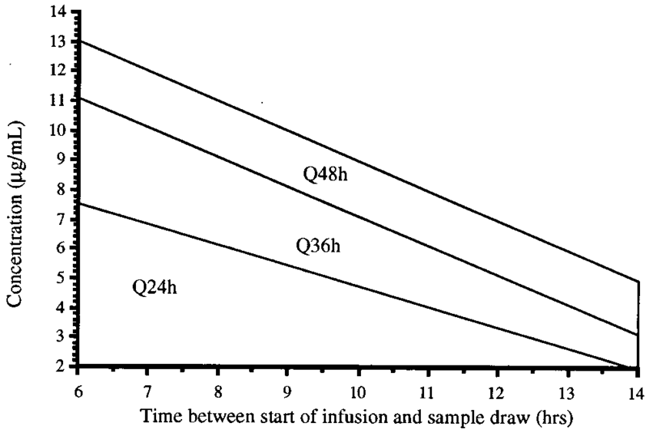
Hartford nomogram: 7 mg/kg
Urban and Craig nomogram: 5 mg/kg
https://www.researchgate.net/figure/ODA-nomogram-for-gentamicin-and-tobramycin-at-7-mg-kg_fig1_15405073
Notes:
Hartford nomogram: use this for 7mg/kg doses
If level is above 48hr, the next dose should not be administered until the gentamicin blood level is <1 ug/mL
Importantly, we change the freq not the dose itself
If borderline, we play it safe
It follows first-order kinetics, essentially meaning that the clearance rate is proportional to the serum concentration

Slide 27
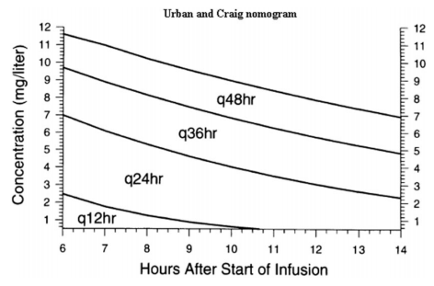
Gentamicin
So we prescribed 400mg on a 5 mg/kg regime, and it’s given at 6.30pm.
You ask the night FY1 to take a gent level at any point between 12.30am-8.30am (6-14hrs post-dose)
Urban and Craig nomogram
What should the FY1 do if a gent level taken at 4.30am comes back at:
3
4
10
prescribe another 400mg dose for 6.30pm that day
prescribe another 400mg dose for 6.30am the following morning
hand over to you the next morning that the patient will need a gent level of <1 before the next dose
http://med.stanford.edu/bugsanddrugs/dosing-protocols/_jcr_content/main/panel_builder/panel_0/download_2/file.res/Aminoglycoside%20Dosing%20Guide%202017-08-23.pdf
Notes:
Works by binding the 30S subunit of the bacterial ribosome, negatively impacting protein synthesis

Slide 28
Gentamicin
So we don’t change the dose of gentamicin, only the frequency
If renal function deteriorates or hearing/vestibular symptoms develop, STOP the gentamicin
Repeat gent levels twice a week
But we shouldn’t really be using gentamicin for longer than a week anyway
Notes:
We don’t change the dose, because we need the peak dose in order for the gentamicin to work properly
And interestingly, it is actually our trough dose which determines how likely we are to develop side effects

Slide 29
Gentamicin
Divided daily dosing:
- endocarditis or creatinine clearance <20 ml/min
- 1-2.5 mg/kg (again, varies from trust to trust)
- we don’t use nomograms
- instead, we wait until the gent level is (usually) <1 before redosing
- therefore requires daily gent levels
Notes:
Aka multiple daily dosing
We may also use divided daily dosing for severe burns, pregnancy, liver failure, etc
This trust actually uses trough doses to guide gentamicin dosing, but for the PSA, it is certainly important to be familiar with the nomograms

Slide 30
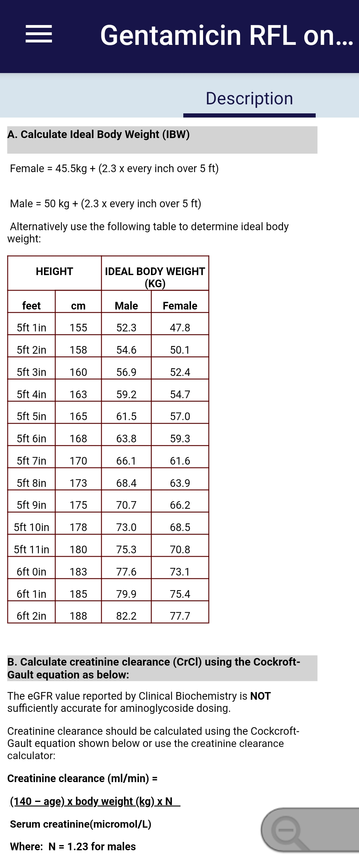
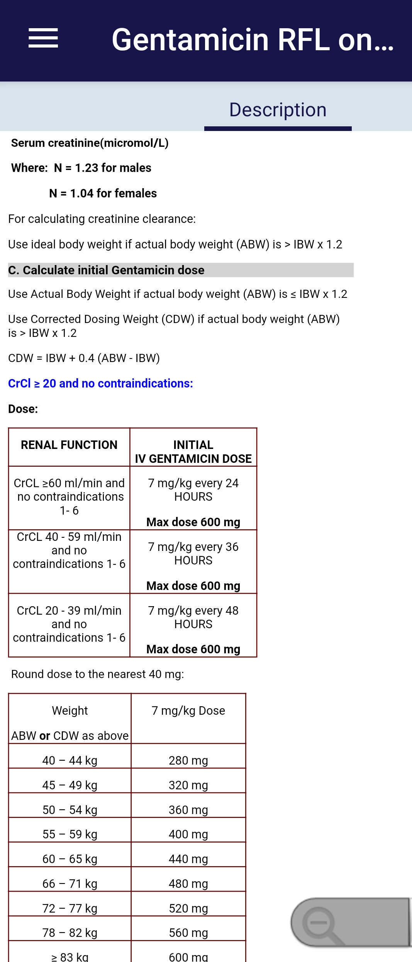
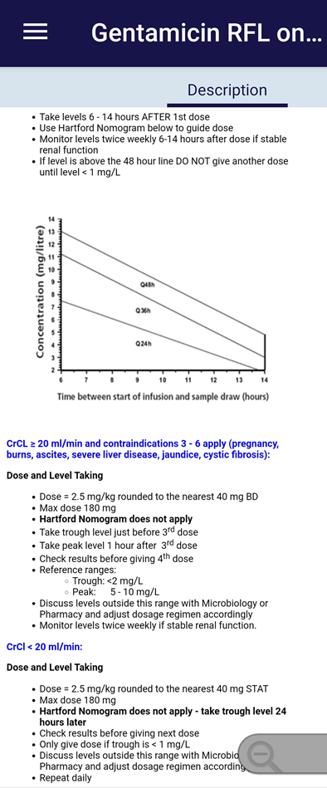
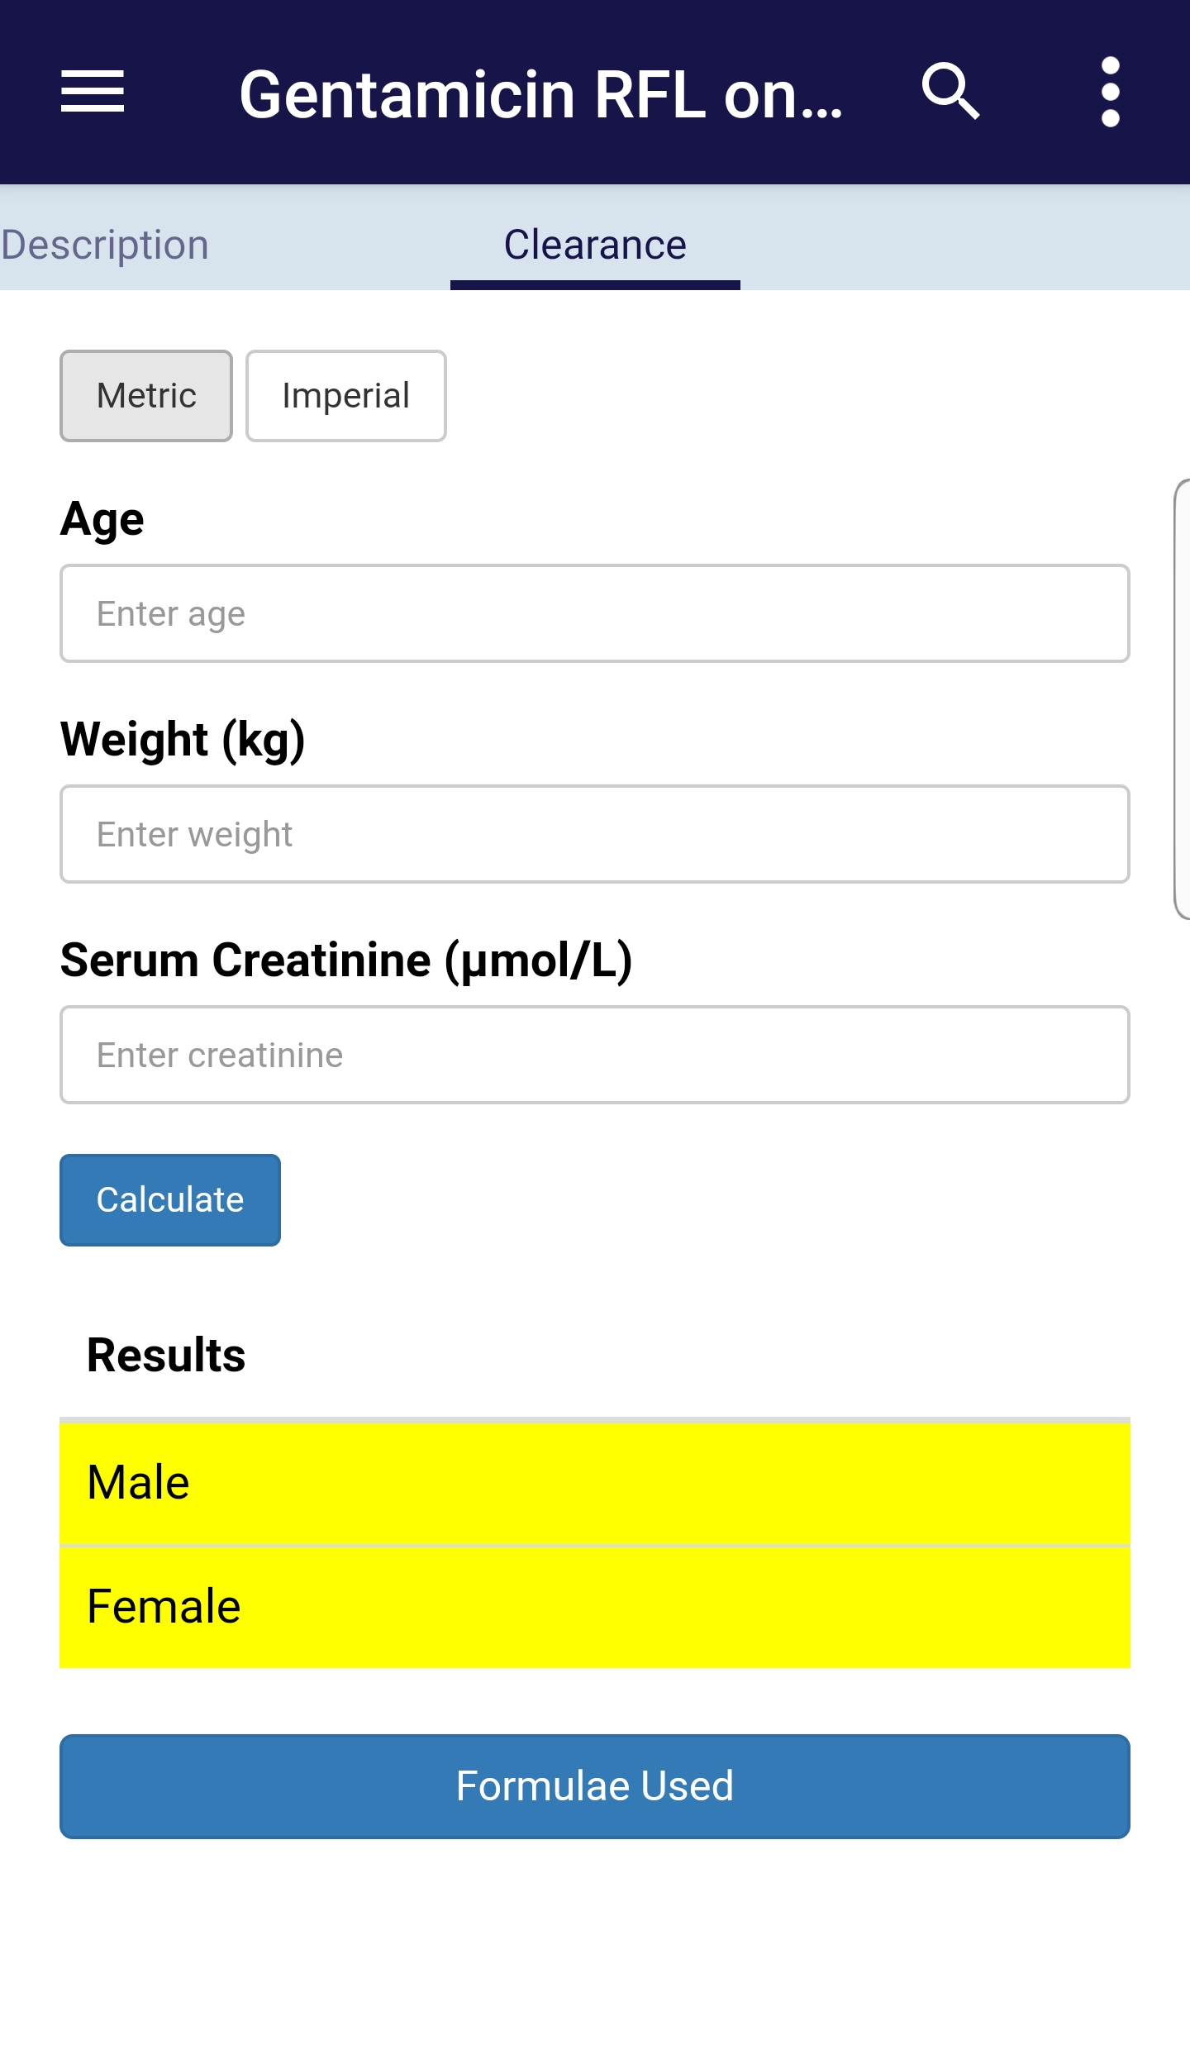
http://www.microguide.eu/

Slide 31
Any questions about gentamicin?

Slide 32
Hypoglycaemia
What symptoms do we expect?
Notes:
Drowsy, low GCS/confusion, sweaty/clammy, dizziness, vomiting, difficulty speaking, shakiness, seizures

Slide 33
Hypoglycaemia
You’re bleeped by a nurse, who explains that Mrs Smith, an 80-year-old woman with diabetes, has a BM of 2.5. What will you prescribe if she is:
alert and talking, but feeling a bit peaky
acutely confused and drowsy with a cannula in-situ
acutely confused and drowsy without a cannula in-situ (and has notoriously difficult veins…)
What else will you do?
Notes:
Works by binding the 30S subunit of the bacterial ribosome, negatively impacting protein synthesis

Slide 34
Hypoglycaemia
a)
b)
c)
Lucozade 225ml, orange juice, toast, biscuits – anything sugary
Notes:
We’re trying to give 10-20g of glucose → each tube of glucogel contains 10g
100% dextrose = 1000mg/ml
10% dex = 100mg/ml of glucose = 100g/l, so 200ml = 20g

Slide 35
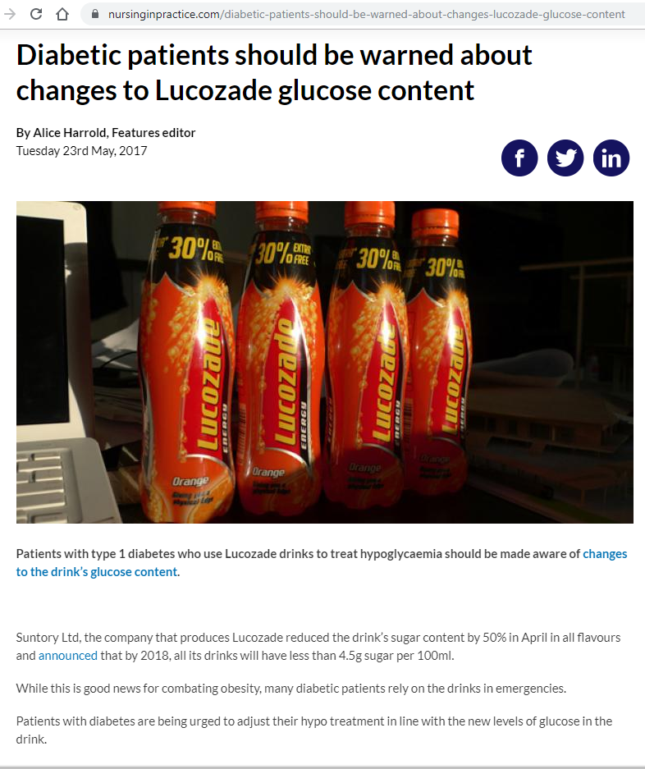

Slide 36
Hypoglycaemia
a)
b)
c)
Lucozade 225ml, orange juice, biscuit – anything sugary
Today STAT Glucogel TT PO Doctor
Today STAT Dextrose 20% - 100ml 30mins IV Doctor
Today STAT Dextrose 10% - 200ml 30mins IV Doctor
Today STAT Glucagon 1mg IM Doctor
Notes:
We’re trying to give 10-20g of glucose → each tube of glucogel contains 10g
100% dextrose = 1000mg/ml
10% dex = 100mg/ml of glucose = 100g/l, so 200ml = 20g

Slide 37
Hypoglycaemia
What else will you do?
Review hypoglycaemic drugs:
- insulin
- sulphonylureas (e.g. gliclazide)
- but not metformin
If not diabetic (rare), screen for sepsis, liver/thyroid disease + ?malignancy
Check BMs every 30mins if low GCS; every 1-2hrs if normal GCS
Aim for BM >5 mmol/L → may need slow IV dextrose infusion if remains low
Notes:
Metformin works by reducing hepatic gluconeogenesis and this usually takes up lactate in the process → hence why inhibiting it can lead to lactic acidosis, especially in the context of renal impairment
It also works by increasing cellular sensitivity to insulin

Slide 38
Hypoglycaemia
Tell me about glucagon!
opposes the effects of insulin
acts to release hepatic glucose stores
so when will using glucagon be ineffective?
- liver disease
- malnourishment
- alcoholics
- fasting patients
- if we’re already used glucagon before
In other words, we can only use it once in an acute setting
Notes:
Glucagon promotes gluconeogenesis and glucogenolysis
Sulphonylureas are insulin secretagogues

Slide 39
Any questions on hypoglycaemia?

Slide 40
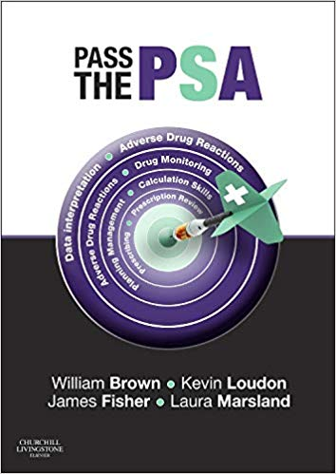
https://www.amazon.co.uk/Pass-Will-Brown-MBBS-MRCP/dp/0702055182

Slide 41
Thank you! Questions? Sign-offs?
www.surveymonkey.com/r/29Z3VF5
Notes:
Oral prednisolone tapering:
Taper over 3-6 weeks
Reducing by 10mg every 3 days
When you hit 10mg per day, reduce to 5mg for 5 days then stop
60mg: 50mg for 3 days, 40mg for 3 days, 30mg for 3 days, 20mg for 3 days, 10mg for 3 days, 5mg for 5 days then stop
Starting oral hypoglycaemics:
if HbA1c >48 mmol/mol (6.5%, 7.8mmol/L) → 42-47 = pre-diabetes
trial diet & exercise
metformin 500mg OD at breakfast
however, if creatinine >150 or weight is low/normal, then use gliclazide 40mg OD at breakfast (because metformin causes appetite suppression)
Increase drug to max dose as tolerated if HbA1c remains static
if on metformin, add a sulphonylurea
If on gliclazide, add a gliptin
after this, refer to diabetologist, who will likely start insulin
Metformin works by inhibiting hepatic gluconeogenesis and increasing sensitivity of cells to insulin

