Slide 1
Lecture 5
Arrhythmias – part 1

Slide 2
Defining arrhythmias
How to work out where arrhythmias come from
Ectopics, escape rhythms & heart block

Slide 3
There’s a lot to cover in this lecture…
…so as a reward, at the end we’re gonna watch a video of a baby living its best life

Slide 4
What do we mean by ‘cardiac rhythm’?
What is an arrhythmia?
Notes:
When we take someone’s pulse and assess the ‘rhythm’, we ask whether it is regular or irregular
This misleadingly suggests that cardiac rhythm is all about the regularity of the heartbeat, and that a regular pulse cannot therefore be generated by an arrhythmia
As we know, in a healthy heart, the sino-atrial node (SAN) acts as the pacemaker and determines the heart rate
There are other parts of the heart with intrinsic pacing potential, such as the bundle of His or the ventricular muscle
However, because the SAN fires faster than these, it is the SAN that therefore determines the rate
(the SAN fires at around 70/min; the AV/bundle of His at 50/min; ventricular muscle at 30min)

Slide 5
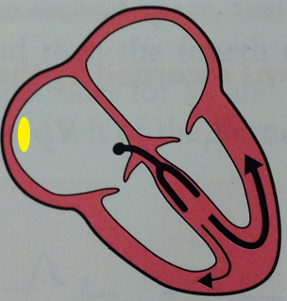
Atrial muscle:
60/min
SAN:
70/min
Ventricular muscle:
30/min
AVN/His:
50/min
“The ECG Made Easy”, John R. Hampton, Eighth Edition, Elsevier Ltd 2013, pg 17
Notes:
As we know, in a healthy heart, the sino-atrial node (SAN) acts as the pacemaker and determines the heart rate
There are other parts of the heart with intrinsic pacing potential, such as the bundle of His or the ventricular muscle
However, because the SAN fires faster than these, it is the SAN that therefore determines the rate
(the SAN fires at around 70/min; the AV/bundle of His at 50/min; ventricular muscle at 30min)

Slide 6
Cardiac rhythm refers to which part of the heart is in control
So what we want to know is ‘Do we have normal sinus rhythm (NSR) or not?’
NSR = sinus origin
Anything that is not NSR is an arrhythmia
NSR does not necessarily mean a normal ECG
+ heart rate between 60-100bpm
+ regular pulse
Notes:
Cardiac rhythm really refers to which part of the heart is in control of the electrical activity
So when we talk about rhythm on an ECG, what we really mean is ‘Is the rhythm of sinus origin or not?’
Technically, any rhythm seen on ECG that is *not* normal sinus rhythm (NSR) is termed an arrhythmia
NSR = sinus rhythm + heart rate between 60-100bpm + regular pulse
Bear in mind that NSR does not have to mean a completely normal ECG: we may still see, for example, axis deviation or some forms of heart block
Many arrhythmias will be regular, and some can be of sinus origin
Technically, arrhythmia should be termed dysrhythmia

Slide 7
How can you tell where an impulse comes from?
Actually, pretty easily!
The 4 places where an impulse can be generated are :
a) SAN (sinus origin)
b) atrial muscle
c) around the AVN/bundle of His
(known as the nodal or junctional complex)
d) the ventricular muscle
supraventricular

Slide 8
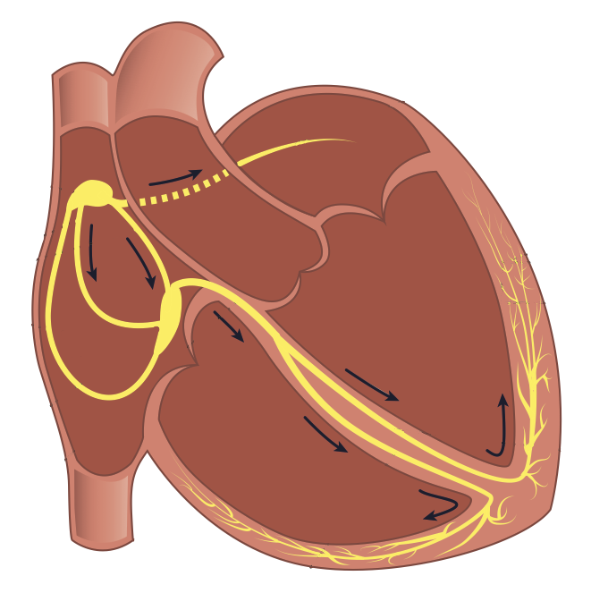
Sinus origin
SAN
AVN
https://thephysiologist.org/study-materials/the-normal-ecg/
http://www.pathophys.org/physiology-of-cardiac-conduction-and-contractility/
Notes:
If the impulse is generated in the SAN, we expect normal P-waves because the impulse depolarises the atrium along the regular conducting pathways
If the impulse is generated in the atrial muscle, then we see abnormal P-waves because the impulse depolarises the atrium in an abnormal manner

Slide 9
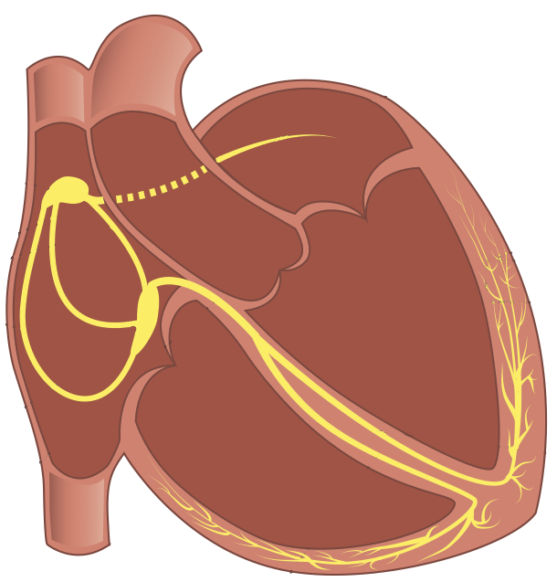
atrial focus
Atrial muscle
https://www.webmd.com/heart-disease/atrial-fibrillation/premature-atrial-contractions
Weird P-wave, normal QRS
http://www.pathophys.org/physiology-of-cardiac-conduction-and-contractility/
Notes:
If the impulse is generated in the SAN, we expect normal P-waves because the impulse depolarises the atrium along the regular conducting pathways
If the impulse is generated in the atrial muscle, then we see abnormal P-waves because the impulse depolarises the atrium in an abnormal manner
The atrial focus can be anywhere in the atria (just not the SAN), so the P-wave can appear in many different ways – there’s no one way an atrial P-wave appears.
Equally, if the atrial focus is near the SAN, it might be impossible to distinguish between that and a sinus beat

Slide 10
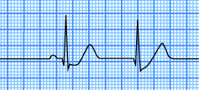
Nodal/junctional
1) Depolarisation of the atria and the ventricles happens at the same time
So the P-wave is hidden in the QRS
Nodal focus
https://learningcentral.health.unm.edu/learning/user/onlineaccess/CE/bac_online/junc/jeb.html
No P-wave, normal QRS
http://www.pathophys.org/physiology-of-cardiac-conduction-and-contractility/
Notes:
A nodal/junctional impulse will not have a P-wave, because there is no atrial depolarisation
We may however see an retrograde P-wave: this is when the impulse spreads back up into the atria and depolarises it (the P-wave is inverted as it travels in the wrong direction)
All three of these supraventricular impulses (SAN, atrial muscle, nodal) will then spread into the ventricles via the normal conduction paths, giving us normal QRS complexes

Slide 11
Nodal/junctional
2) Depolarisation of the atria happens slightly before the ventricles
So we visualise atrial depolarisation happening the wrong way
Nodal focus
https://quizlet.com/133320717/c5-junctional-rhythms-flash-cards/
Inverted (retrograde) P-wave, normal QRS
http://www.pathophys.org/physiology-of-cardiac-conduction-and-contractility/
Notes:
A nodal/junctional impulse will not have a P-wave, because there is no atrial depolarisation
We may however see an retrograde P-wave: this is when the impulse spreads back up into the atria and depolarises it (the P-wave is inverted as it travels in the wrong direction)
All three of these supraventricular impulses (SAN, atrial muscle, nodal) will then spread into the ventricles via the normal conduction paths, giving us normal QRS complexes

Slide 12
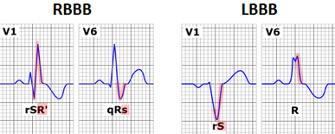
All supraventricular impulses will have a normal QRS complex
However, be careful of bundle branch block
A supraventricular tachycardia with a bundle branch block may look like a ventricular tachycardia
https://en.wikipedia.org/wiki/Bundle_branch_block
Notes:
This is why we say that the presence of bundle branch block means we can no longer interpret the ECG

Slide 13
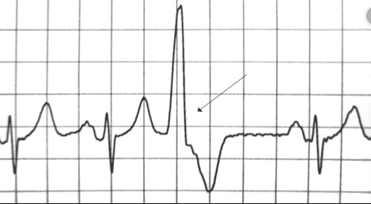
Ventricular focus
Ventricular muscle
Depolarisation of the atria & ventricles down abnormal pathways
https://en.wikipedia.org/wiki/Premature_ventricular_contraction
Weird & wide QRS, no P-wave, weird T-wave
http://www.pathophys.org/physiology-of-cardiac-conduction-and-contractility/
Notes:
If the impulse comes from the ventricles, there will be no P-wave and the QRS complex will look wide and weird because it does not spread via the conducting system
We may also see weird T-waves, because the repolarisation pattern will be different
We don’t see a P-wave because it is either hidden in the QRS or atrial depolarisation doesn’t happen at all

Slide 14
How can we tell where an impulse comes from?
P-wave present?
Y
N
P-wave normal?
Normal QRS complex?
Y
N
Y
N
SAN
P-waves inverted?
Nodal/junctional
Ventricular
Y
N
Nodal/junctional
Atrial
Using this, we can work out the origin of any impulse, regardless of the type of arrhythmia

Slide 15
How can we categorise arrhythmias?
We can split arrhythmias into those of:
1) Sinus origin
2) Non-sinus origin

Slide 16
Arrhythmias of sinus origin

Slide 17
Arrhythmias of sinus origin
NSR = sinus origin + heart rate between 60-100bpm + regular pulse
We expect normal P-waves, normal QRS complexes, constant PR interval, etc
Sinus arrhythmia:
Irregular pulse, which varies with breathing → very common in young people
https://ekg.academy/learn-ekg?courseid=313&seq=7
Notes:
NSR = sinus rhythm + heart rate between 60-100bpm + regular pulse
As the following are all sinus rhythm, we expect normal P-waves, normal QRS complexes, constant PR interval, etc
1) Sinus arrhythmia: irregular pulse, which slows on breathing
Very common in young people
Anyone in this room have a sinus arrhythmia?
When you breathe in, you raised intrathoracic pressure, which is detected by the baroreceptors in your aortic arch and carotid sinus. So your body thinks your blood pressure has increased and reduces your heart rate to compensate
Cardiac output = heart rate x stroke volume
Arterial blood pressure = cardiac output x total peripheral resistance
ABP = heart rate x stroke volume x TPR
This reflects the fact that your SAN is very sensitive to modulation by your sympathetic & parasympathetic nervous systems – we don’t tend to see this variation in impulses generated from other parts of the heart, as they do not receive the same autonomic input

Slide 18
Arrhythmias of sinus origin
https://www.slideshare.net/AnnBentley/sinus-bradycardia
2) Sinus bradycardia: HR <60bpm
Seen in fit young people
Also seen in hypothermia, hypothyroidism and following an MI
3) Sinus tachycardia: HR >100 bpm
Many causes! Think fight or flight response (fear/pain), exercise, shock, anaemia, hyperthyroidism, etc - anything else?
http://physioknowledgebd.blogspot.com/2016/02/sinus-tachycardia.html
PE
Notes:
2) Sinus bradycardia: HR <60bpm
Seen in fit young people
Also seen in hypothermia, hypothyroidism and immediately after an MI
3) Sinus tachycardia: HR >100 bpm
Many causes! Think fight or flight response (fear/pain), exercise
Any cause of shock, anaemia, hyperthyroidism, etc
Heart rate = 300/no of large squares between R waves (R-R interval)
1 small square = 0.04s, 1 big square = 0.2s, so 1 second = 5 square

Slide 19
https://www.youtube.com/watch?v=lsm6kpWjNT8

Slide 20
Arrhythmias of non-sinus origin
These are the ones cardiologists really care about – why?

Slide 21
Arrhythmias of non-sinus origin
These are the ‘real’ arrhythmias
There are 6 main reasons why the heart will generate non-sinus impulses:
1) Ectopics
2) Escape rhythms
3) Heart block
4) Pre-excitation syndromes
5) Re-entrant arrhythmias
6) Fibrillation
Notes:
These are the ‘real’ arrhythmias
There are only really 6 reasons why the heart will generate non-sinus impulses:
1) Conduction blocks
2) Ectopics
3) Escape rhythms
4) Pre-excitation syndromes
5) Re-entrant arrhythmias
6) Fibrillation
Some arrhythmias will be combinations of these types, and there is a lot of overlap between them

Slide 22
Arrhythmias of non-sinus origin
Ectopics
Escape rhythms
Heart block
Pre-excitation syndromes
Re-entrant arrhythmias
Fibrillation
Notes:
We’ve already talked about heart block in previous lectures so these concepts shouldn’t be new!

Slide 23
Ectopics (aka extra-systoles or premature contractions)
A non-sinus node may gain ‘enhanced automaticity’ (electrolyte disturbances, thyroid problems, caffeine, alcohol, drugs etc)
i.e. it becomes a bit gung-ho and discharges when it shouldn’t
Notes:
A non-sinus node (e.g bundle of His, ventricular muscle) may gain ‘enhanced automaticity’ (i.e. becomes a bit gung-ho)
Thus, it may fire when it shouldn’t, creating a heart beat out of sync with the sinus rhythm
This can be a single beat (premature contraction) or a prolonged rhythm
Single premature contractions are asymptomatic and usually of no clinical significance
Prolonged ectopics can create problematic tachyarrhythmias, as we shall see later…
As with all arrhythmias, ectopics can originate from the atrial muscle, the nodal/junctional region or from the ventricular muscle
Using our handy flowchart, we can work out whereabouts they are from

Slide 24
https://dissolve.com/stock-photo/False-start-race-woman-running-against-royalty-free-image/101-D25-45-387

Slide 25
Ectopics (aka extra-systoles or premature contractions)
A non-sinus node may gain ‘enhanced automaticity’
i.e. it becomes a bit gung-ho and discharges when it shouldn’t
This can be a single beat or a prolonged rhythm
Single ectopics are asymptomatic and of no clinical significance
Notes:
A non-sinus node (e.g bundle of His, ventricular muscle) may gain ‘enhanced automaticity’ (i.e. becomes a bit gung-ho)
Thus, it may fire when it shouldn’t, creating a heart beat out of sync with the sinus rhythm
This can be a single beat (premature contraction) or a prolonged rhythm
Single premature contractions are asymptomatic and usually of no clinical significance
Prolonged ectopics can create problematic tachyarrhythmias, as we shall see later…
As with all arrhythmias, ectopics can originate from the atrial muscle, the nodal/junctional region or from the ventricular muscle
Using our handy flowchart, we can work out whereabouts they are from

Slide 26
Ectopics
Single ectopic beats always occur before we expect the next QRS to appear
a) Atrial ectopics: funny P-waves, normal QRS complexes
https://www.webmd.com/heart-disease/atrial-fibrillation/premature-atrial-contractions#1
b) Junctional/nodal ectopics: no P-wave or inverted P-wave, normal QRS
http://www.medicine-on-line.com/html/ecg/e0001en_files/08.htm

Slide 27
Ectopics
c) Ventricular ectopics: aka premature ventricular contractions (PVCs)
No P-wave, wide abnormal QRS complexes, weird T-waves
https://thephysiologist.org/study-materials/ectopic-beats-palpitations/
Most ectopics are benign and require no treatment – reduce caffeine/alcohol
Notes:
We’ve focused here on single ectopics, but we will return to prolonged ectopics next lecture

Slide 28
Arrhythmias of non-sinus origin
Ectopics
Escape rhythms
Heart block
Pre-excitation syndromes
Re-entrant arrhythmias
Fibrillation

Slide 29
Escape rhythms
These look exactly the same as ectopic beats
However, they come after we’d expect the next beat to occur, unlike ectopics which come before
These represent a failure of the SAN to fire when it should
As such, these impulses ‘escape’ from their regular inhibition by the SAN
Unlike benign single ectopics, escape beats are protective and may be life-saving
Notes:
In terms of the ECG, these look exactly the same as ectopic beats
However, they come after we’d expect the next beat to occur, unlike ectopics which come before
These represent a failure of the SAN to fire when it should
As such, these impulses occur because they ‘escape’ from their regular inhibition by the SAN
Unlike benign single ectopics, escape beats are protective and may be life-saving

Slide 30
https://www.runnersworld.com/news/a20793787/the-story-behind-this-viral-boston-marathon-photo/

Slide 31
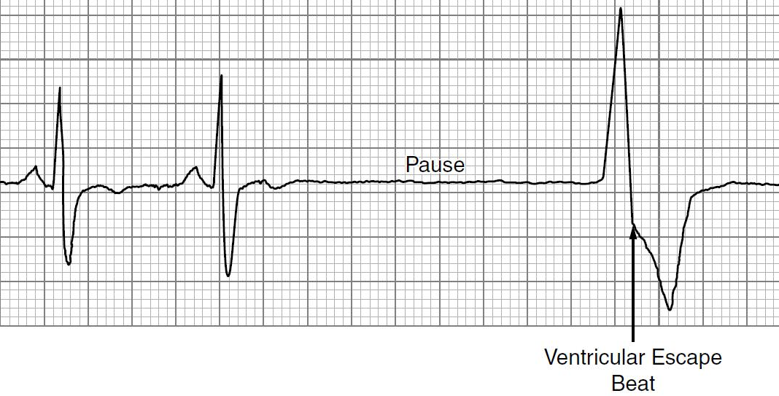
Escape rhythms
http://www.medicine-on-line.com/html/ecg/e0001en_files/08.htm
Atrial escape: abnormal P-waves, normal QRS
Junctional/nodal escape: no/inverted P-wave, normal QRS
https://ekg.academy/learn-ekg?courseid=314&seq=8
Ventricular escape: no P-wave, weird QRS complex
https://brilliantnurse.com/ekg-sinus-node-related-dysrhythmias/

Slide 32
Escape rhythms: sick sinus syndrome
Caused by a faulty ‘sick’ SAN
The damaged SAN generates impulses at a slower rate than usual, producing a sinus bradycardia
At times, the SAN fails to depolarise at all, forcing escape rhythms to develop
We see rapidly-alternating bradycardias and tachycardias
This is also (creatively) known as tachycardia-bradycardia syndrome
Notes:
As we know, our sino-atrial node generates our sinus rhythm
So, as the name suggests, sick sinus syndrome is caused by a faulty sino-atrial node
Because the SAN is damaged, it generates impulses at a slower rate than usual, producing a sinus bradycardia
At times, the SAN fails to depolarise at all, forcing escape rhythms to develop
Sometimes, the lack of SAN activity allows a number of abnormal tachycardias to develop (fast AF, supraventricular tachycardia, etc)
If so, we see rapidly-alternating bradycardias (sinus bradycardia, prolonged escape rhythms) and tachycardias
This form of sick sinus syndrome is (creatively…) known as tachycardia-bradycardia syndrome
Often presents with syncope

Slide 33
Sick sinus syndrome
https://thoracickey.com/sick-sinus-syndrome-2/

Slide 34
Escape rhythms: sick sinus syndrome
Caused by a faulty SAN
The damaged SAN generates impulses at a slower rate than usual, producing a sinus bradycardia
At times, the SAN fails to depolarise at all, forcing escape rhythms to develop
We see rapidly-alternating bradycardias and tachycardias
This is also (creatively) known as tachycardia-bradycardia syndrome
Often presents with syncope
What’s the definitive treatment for this condition?
Pacemaker
Notes:
As we know, our sino-atrial node generates our sinus rhythm
So, as the name suggests, sick sinus syndrome is caused by a faulty sino-atrial node
Because the SAN is damaged, it generates impulses at a slower rate than usual, producing a sinus bradycardia
At times, the SAN fails to depolarise at all, forcing escape rhythms to develop
Sometimes, the lack of SAN activity allows a number of abnormal tachycardias to develop (fast AF, supraventricular tachycardia, etc)
If so, we see rapidly-alternating bradycardias (sinus bradycardia, prolonged escape rhythms) and tachycardias
This form of sick sinus syndrome is (creatively…) known as tachycardia-bradycardia syndrome
Often presents with syncope

Slide 35
Arrhythmias of non-sinus origin
Ectopics
Escape rhythms
Heart block
Pre-excitation syndromes
Re-entrant arrhythmias
Fibrillation

Slide 36
Heart block
3rd-degree heart block:
Normal P-waves (sinus component)
Weird & wide QRS complex (ventricular escape)
No relationship between the two
Needs a pacemaker
http://www.pathophys.org/physiology-of-cardiac-conduction-and-contractility/
Notes:
In 3rd-degree heart block, the impulse from the SAN can’t reach the ventricles, so the ventricles have to generate their own
So we see normal P-waves mixed in with weird, wide QRS complexes, with no relationship between the two
Other types of heart block (1st-degree, bundle branch block, hemiblock) don’t affect the rhythm in this way, so can have ‘NSR with 1st-degree block’, for example
2nd-degree heart block creates an irregular pulse but all the impulses are of sinus origin
So we would term this an arrhythmia, based on our definition of NSR

Slide 37
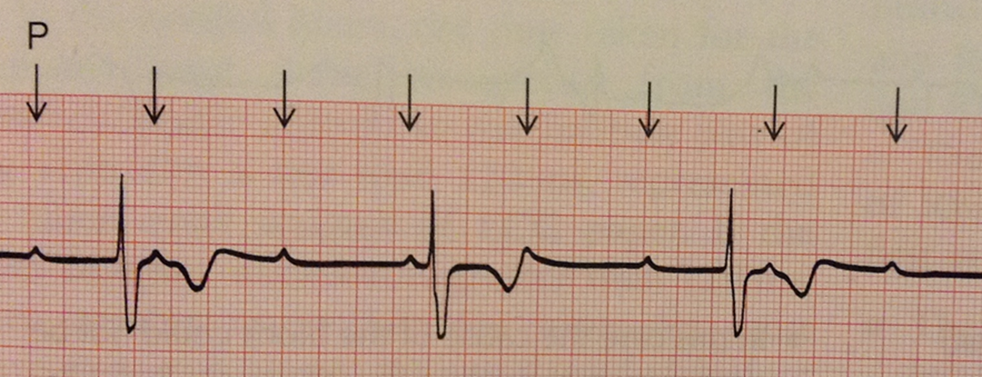
3rd-degree heart block
“The ECG Made Easy”, John R. Hampton, Eighth Edition, Elsevier Ltd 2013, pg 41
The QRS frequency is much lower than the P-wave frequency

Slide 38
Heart block
What type of heart block is this?
Second-degree (Mobitz type 1/Wenckebach)
Second degree heart block is due to delays within/around the AVN
So these rhythms are all of sinus origin, just that the P-wave gets held up at the AVN
So technically second-degree heart blocks are arrhythmias of sinus origin
Notes:
This is a Mobitz type 1 (Wenckebach) block (second-degree heart block) – block within the AVN
Mobitz type 2 is a block below the AVN
Not all the P-waves can progress through to the ventricles so we see this pattern
Mobitz type 2 is far more serious than type 1 and will often progress to third degree heart block

Slide 39
Arrhythmias of non-sinus origin
Ectopics
Escape rhythms
Heart block: 3rd-degree (and 2nd-degree…)
Pre-excitation syndromes
Re-entrant arrhythmias
Fibrillation

Slide 40
Quiz!
https://wiley-vch.e-bookshelf.de/products/reading-epub/product-id/752797/title/bennett%27s+cardiac+arrhythmias.html
Junctional/nodal ectopic (inverted P-wave)

Slide 41
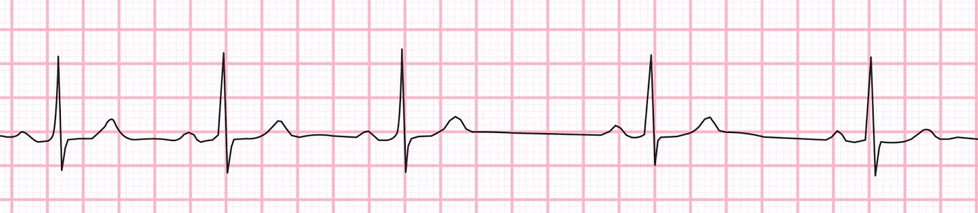
https://ecg-educator.blogspot.com/2016/11/sinus-arrhythmia.html
Sinus arrhythmia

Slide 42
http://floatnurse-mike.blogspot.com/2015/01/various-escape-beats.html
Ventricular escape

Slide 43
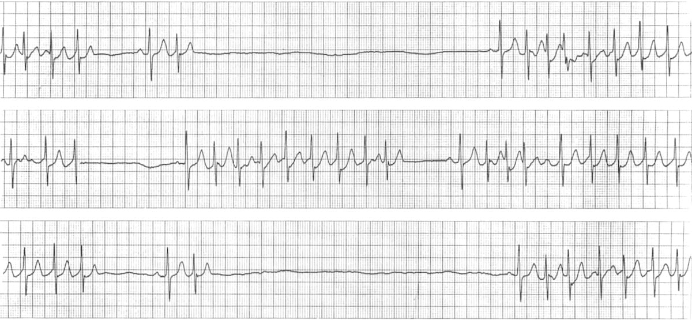
https://litfl.com/sinus-node-dysfunction-sick-sinus-syndrome/
Sick sinus syndrome
Notes:
A pretty extreme case!

Slide 44
https://www.openpediatrics.org/assets/image/rhythm-strip-sinus-tachycardia
Sinus tachycardia

Slide 45
Well done everyone…
https://www.youtube.com/watch?v=lsm6kpWjNT8

Slide 46
Thanks! Questions?
www.surveymonkey.com/r/29Z3VF5

