Slide 1
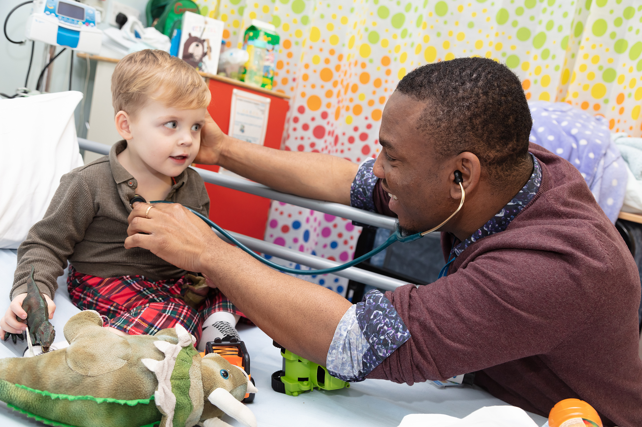
Welcome to the South Thames Foundation School
Information for new F1 doctors August 2022

Slide 2
New 2021 Foundation Curriculum
Three higher level outcomes
13 Foundation Professional Capabilities – FPCs
To be learnt across different healthcare settings and evidenced in portfolio – lots more info on UKFPO website

Slide 4
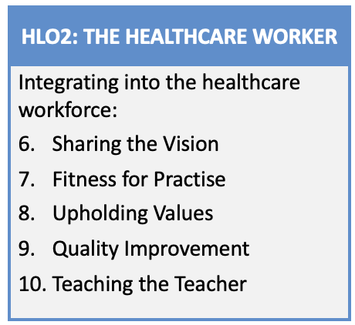

Slide 5
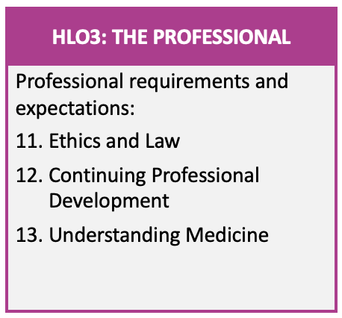

Slide 6
Horus e-portfolio – an educational tool
Important that you learn how to use this early on to benefit your training – now and in the future
Educational planning
Reinforce your learning
Record of achievements
Not just a tick box exercise . . . .
Further information on national Horus website
https://supporthorus.hee.nhs.uk/ and foundation school web page - https://lonkssfoundation.hee.nhs.uk/horus

Slide 7
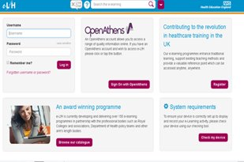
e-LFH https://portal.e-lfh.org.uk
e-learning modules for foundation
useful to support your experiential learning
to catch up if you miss a teaching session
user names / passwords will be sent to you
Notes:
User names and passwords should have been supplied for all of your foundation doctors.

Slide 8
STFS
Currently virtual
Will be uncoupling in August 2023 into KSS FS and part of London FS – further information in due course
All enquiries via 020 7866 3216 or Support Portal
https://lasepgmdesupport.hee.nhs.uk/support/home
Policies currently on STFS web page https://lonkssfoundation.hee.nhs.uk

Slide 9
Email addresses
Ensure that you have a functioning professional e-mail address and that you have informed STFS (avoid Hotmail etc as spam filters can block STFS mails)
Important to separate social and professional e-mails and identity – e.g. if you use Facebook link it to an e-mail address to which patients do not have access

Slide 10
Social media
Take care
Employer’s policies plus guidance from GMC and BMA
Separate private from professional
Ensure patient confidentiality never breached
Care with WhatsApp – an indecent image sent to you is now on your phone!

Slide 11
STFS communications
Please maintain your notified email address and check it weekly – do not auto-forward as original email service may close
Enables information about GMC registration, careers etc to be sent out - to help you
Foundation bulletins sent regularly – also available on website
All new information also on STFS web page
Notes:
Please do check the information sent regularly so you don’t miss anything

Slide 12
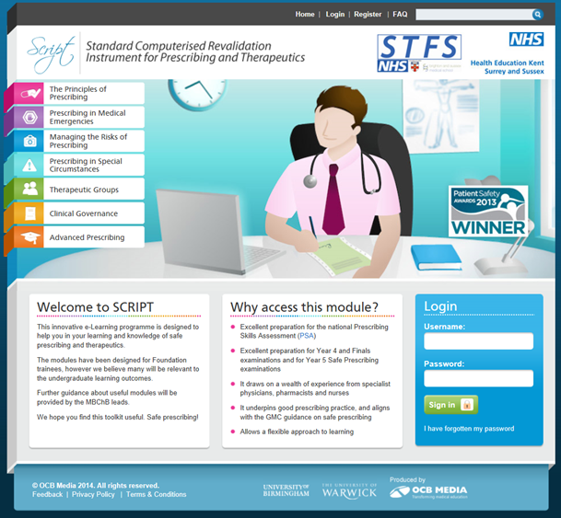
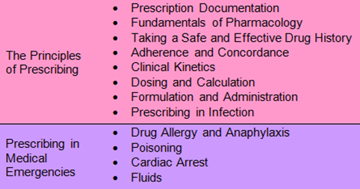
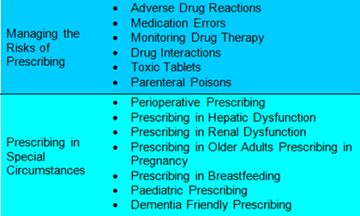
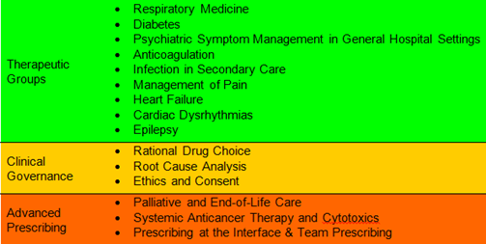
SCRIPT (Standard Computerised Revalidation Instrument for Prescribing and Therapeutics)
http://kss3.safeprescriber.org/login
41 modules on various aspects & topics of prescribing
Available to all STFS doctors
Easy to use platform, interactive
Certificates produced for each module
Modules to be completed as directed by your trust and as to your own educational needs but you must do at least 6 each year
Notes:
Mention any local variations

Slide 13
Prescribing Safety Assessment (PSA)
Passing the Prescribing Safety Assessment is now essential for successful completion of the F1 year
If you have not yet passed, or passed more than 2 years ago, you will need to sit the PSA.
Ask your Foundation Administrator about arrangements – next sitting 6 Sept 2022, 2 further sittings in March and April 2023
Ask your FTPD/prescribing lead about suitable SCRIPT modules to help you

Slide 14
Who will supervise you*?
Educational supervisor*
supervises you for full year
will meet you formally at start and end of placements and other times as necessary
Clinical supervisor*
supervises you for one placement (eg 4 months in paediatrics)
meets you at beginning and end of placement and other times as necessary
Foundation Programme Director
Supervises 20-40 foundation doctors
Oversees programmes
Placement Supervision Group
Led by consultant / GP and includes senior colleagues in your team
Liaises with clinical supervisor
*NB names and contact details will be provided by Trust

Slide 15
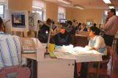
PATIENT SAFETY AND YOUR SUPERVISION
You should know who is supervising your clinical practice at all times (usually a consultant or experienced middle grade doctor)
The clinician supervising you must be sufficiently competent to do so
You should be able to contact your supervisor if you are concerned about a patient
You should never be forced to work beyond your competence
If you are concerned that your unit is regularly not adhering to these principles, please contact your educational supervisor or foundation training programme director
Notes:
The word regularly is there so that FDs do not report any isolated event eg a registrar phoning in sick

Slide 16
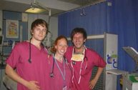
Your trust should provide you with:
Appropriate learning experience
Weekly education e.g. teaching sessions, teaching ward rounds, clinics etc
Access to the Guardian of Safe Working Hours
Access to careers advice / guidance
Representation at local faculty group via elected F1 Representative
F1s can “borrow” 5 days of F2 study leave for a taster
Notes:
F1 ‘study leave’ in new contract is used for weekly teaching

Slide 17
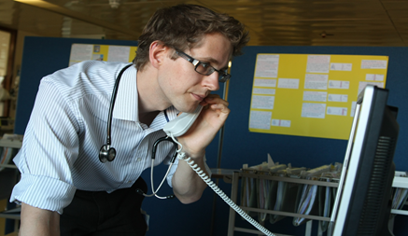
Raising concerns / ‘whistle-blowing’ – GMC guidance
You must protect patients from risk of harm posed by another colleague's conduct, performance or health. The safety of patients must come first at all times
If you have concerns that a colleague may not be fit to practise, you must take appropriate steps without delay, so that the concerns are investigated and patients protected where necessary
More information on local trust policy

Slide 18
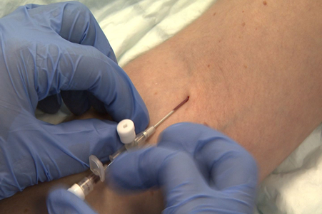
Protecting patients (and you)
F1 doctors must NOT
Site mark (except under direct supervision by the operator)
Prescribe or administer cytotoxic or immunosuppressant drugs (except corticosteroids)
Inject contrast unless trained to do so
Notes:
Detailed document on roles and responsibilities of foundation doctors on the STFS website

Slide 19
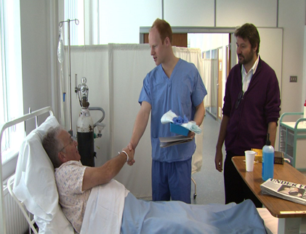
Consent
Taking consent is the responsibility of the doctor performing the procedure
If a FD is not capable of carrying out a procedure, s/he may only obtain consent for it when trained to do so, directly supervised, and under delegation from the experienced doctor carrying out that procedure
Notes:
This refers to procedures which the F1 doctor is NOT competent to undertake

Slide 20
ARCP Annual Review of Competence Progression
Process to ensure that you have met foundation requirements (similar applies in specialty training)
List of requirements on STFS web page. These must be met and e portfolio ready for review by May (date to be advised)
Meet your ES in April to review
Also, complete Form R in e Portfolio – self declaration of fitness to practise
Further details will be sent to you by STFS nearer the time in the fortnightly bulletin

Slide 21
Leaving early
If you wish to leave before the official end date of your F1 or F2 programme in order to take up other employment/training opportunities, you will not be signed off as having met foundation training requirements.
Leaving early is a major decision, requiring careful thought. The STFS directors are happy to meet you to discuss
If you leave early, you MUST complete a withdrawal form, please visit the Support Portal for more detail. If you do not complete a form your vacancy may not be filled, putting patients at risk

Slide 22
And if I am not signed off?
Arrangements will depend on circumstances eg
Remedial training
Additional 4 months / repeat entire year
Spend 2-4 weeks at start of F2 as an F1

Slide 23
Asking for advice about your training
Usually ask locally first, eg your educational supervisor or FPTD
STFS must know if it may affect your training programme:
You have been or need to be away, for example for illness for > 2 weeks or maternity leave
You wish to take time out / work less than full time
Special circumstances which may affect your placement
You are having problems with your training
Raising concerns which you feel have been inadequately dealt with locally
If so please check the policy and deadlines on the Support Portal

Slide 24
Support available
Locally in trust
Educational / clinical supervisors
Postgraduate/Medical Education Team
Occupational Health
Medical Staffing
Employee Assistance Programme
Outside trust
https://london.hee.nhs.uk/professional-development

Slide 25
SuppoRTT - Supported return to training
Support is provided for doctors returning after an absence of three months or more, e.g. after maternity leave
Discuss arrangements with your educational supervisor before you go away
A variety of support offered including a week of paid shadowing before restarting
https://london.hee.nhs.uk/professional-development/supported-return-training
Each trust has a consultant SuppoRTT champion

Slide 26
Feedback to STFS
Foundation programme trainee representative at all trusts – can raise issues locally
Trainee representatives at STFS committees – inform and influence future directions
Online questionnaires – please contribute as your views are valued!

Slide 27
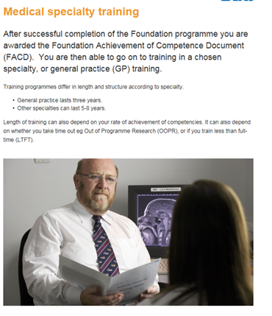
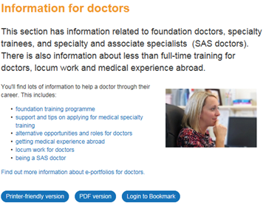
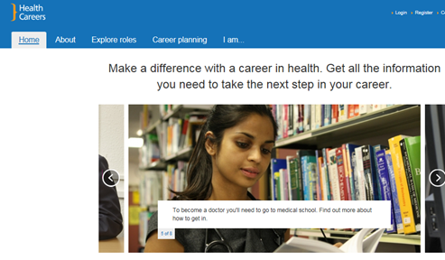
Careers
Careers support and resources available via your trust/webinars
Four stage approach to career management – https://london.hee.nhs.uk/careers-unit
Informal short one-2-one career sessions
Group teaching introducing career planning
Up to 5 days of your F2 study leave entitlement can be taken towards the end of F1 for a ‘taster’ to explore career options
www.healthcareers.nhs.uk for further ideas
Notes:
www.healthcareers.nhs.uk is the national careers website. Please mention what is available locally for your foundation doctors.

