Slide 1
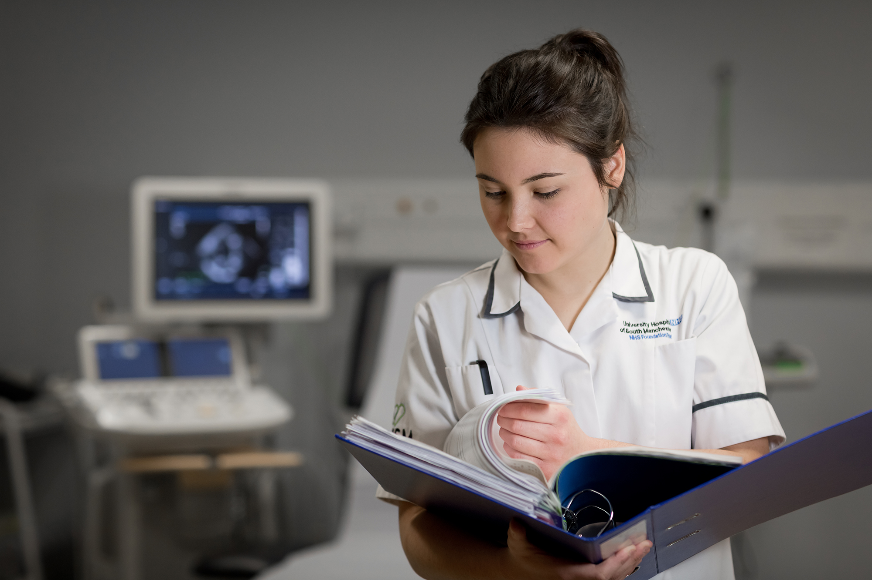
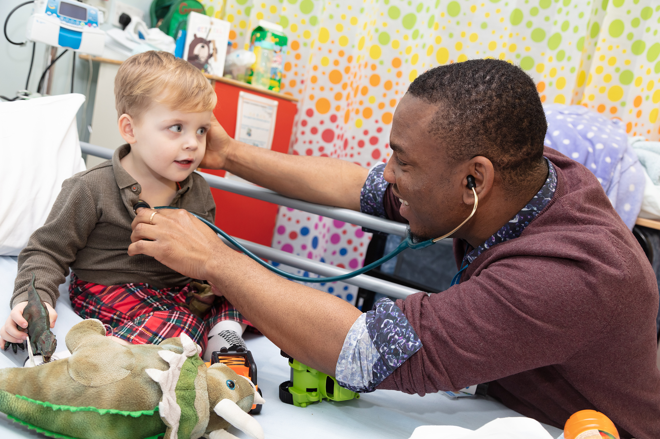
Welcome to the South Thames Foundation School
Information for new F2 doctors August 2022

Slide 2
STFS – contacts reminder
Currently virtual
Will be uncoupling in August 2023 into KSS FS and part of London FS – but should not affect you unless you need to extend your training
Usually based in Stewart House, Russell Square
All enquiries via 020 7866 3216 or Support Portal
https://lasepgmdesupport.hee.nhs.uk/support/home
Policies on STFS web page https://lonkssfoundation.hee.nhs.uk

Slide 3
Email addresses
Ensure that you have a functioning professional e-mail address and that you have informed STFS (avoid Hotmail etc as spam filters may block STFS mails)
Important to separate social and professional e-mails and identity – eg if you use facebook link it to an e-mail address to which patients do not have access

Slide 4
Social media
Take care
Employer’s policies plus guidance from GMC and BMA
Separate private from professional
Ensure patient confidentiality never breached
Care with WhatsApp – an indecent image sent to you is now on your phone!

Slide 5
STFS communications
Please maintain your notified email address and check it weekly – do not auto-forward as original email service may close
Enables information about GMC registration, careers etc to be sent out - to help you
STFS bulletins sent regularly – also available on website
All new information also on STFS web page
Notes:
Please do check the information sent regularly so you don’t miss anything

Slide 6
Horus e-portfolio – an educational tool
Even more important with new curriculum
Further information on national Horus website https://supporthorus.hee.nhs.uk/ and foundation school web page - https://lonkssfoundation.hee.nhs.uk/horus

Slide 7
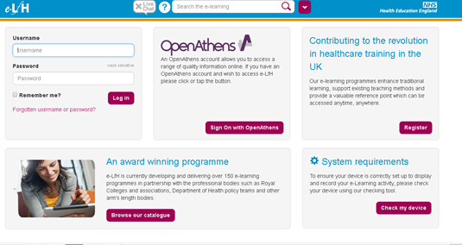
e-LFH https://portal.e-lfh.org.uk
e learning modules for foundation
useful to support your experiential learning
to catch up if you miss a teaching session
Notes:
User names and passwords should have been supplied for all of your foundation doctors.

Slide 8
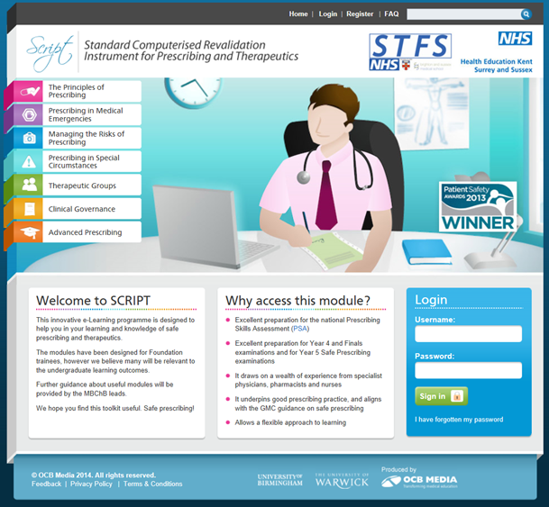
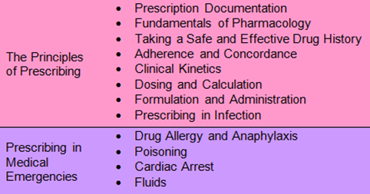
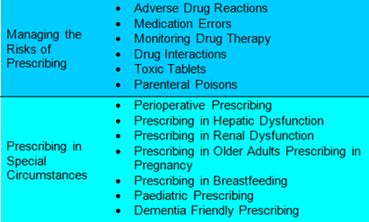
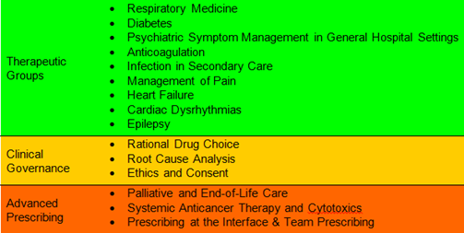
SCRIPT (Standard Computerised Revalidation Instrument for Prescribing and Therapeutics)
http://kss3.safeprescriber.org/login
41 modules on various aspects & topics of prescribing
Available to all STFS doctors
Easy to use platform, interactive
Certificates produced for each module
Modules to be completed as directed by your trust and as to your own educational needs but you must do at least 6 this year

Slide 9
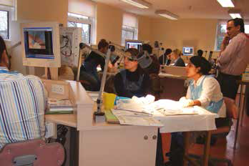
PATIENT SAFETY AND YOUR SUPERVISION
You should know who is supervising your clinical practice at all times (usually a consultant or experienced middle grade doctor)
The clinician supervising you must be sufficiently competent to do so
You should be able to contact your supervisor if you are concerned about a patient
You should never be forced to work beyond your competence
If you are concerned that your unit is regularly not adhering to these principles, please contact your educational supervisor or foundation training programme director
Notes:
The word regularly is there so that FDs do not report any isolated event i.e. a registrar phoning in sick

Slide 10
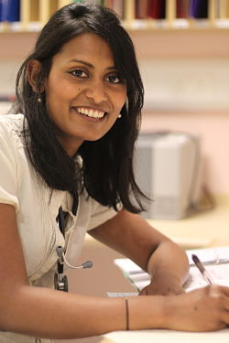
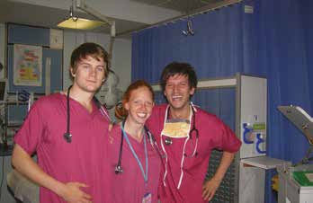
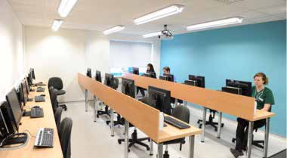
Your trust should provide you with:
Appropriate learning experience
Education weekly or in blocks eg teaching sessions, teaching ward rounds, clinics etc
Access to the Guardian of Safe Working Hours
Access to careers advice / guidance
Representation at local faculty group via elected F2 Representative

Slide 11
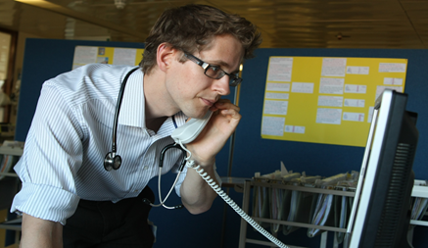
Raising concerns / ‘whistle-blowing’ – GMC guidance
You must protect patients from risk of harm posed by another colleague's conduct, performance or health. The safety of patients must come first at all times
If you have concerns that a colleague may not be fit to practise, you must take appropriate steps without delay, so that the concerns are investigated and patients protected where necessary
More information on local trust policy

Slide 12
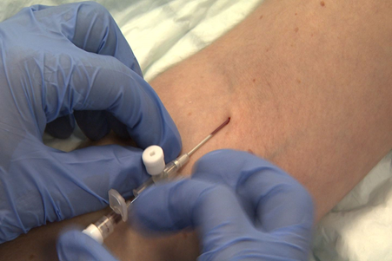
Protecting patients (and you)
F2 doctors must NOT
Site mark (except under direct supervision by the operator)
Inject contrast unless trained to do so
Notes:
Detailed document on roles and responsibilities of foundation doctors on the STFS website

Slide 13
Protecting patients (2)
F2 doctors must NOT:
initiate or administer cytotoxic or immunosuppressant drugs (except corticosteroids)
F2 doctors should ONLY:
prescribe the above drugs following training and when assessed as competent to do so

Slide 14
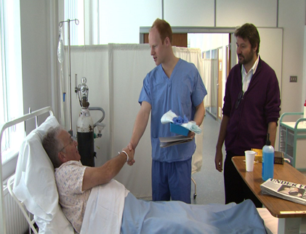
Consent
Taking consent is the responsibility of the doctor performing the procedure
If a FD is not capable of carrying out a procedure, s/he may only obtain consent for it when trained to do so, directly supervised, and under delegation from the experienced doctor carrying out that procedure
Notes:
This refers to procedures which the F1 doctor is NOT competent to undertake

Slide 15
ARCP Annual Review of Competence Progression
Process to ensure that you have met foundation requirements (similar applies in specialty training)
List of requirements on STFS web page. These must be met and e portfolio ready for review by May (date to be advised)
Meet your ES in April to review
Also complete Form R in e Portfolio – self declaration of fitness to practise
Further details will be sent to you by STFS nearer the time in the fortnightly bulletin

Slide 16
Revalidation
Every doctor who is fully registered with a licence to practise will need to revalidate.
STFS will provide all relevant information during the course of the year
For doctors in KSS trusts
Designated body = HEE Kent, Surrey and Sussex
Responsible officer = HEE KSS Postgraduate Dean
For doctors in South London trusts
Designated body = HEE South London
Responsible officer = HEE South London Postgraduate Dean
Any queries please contact Support Portal

Slide 17
Leaving early
If you wish to leave before the official end date of your F2 programme in order to take up other employment/training opportunities, you will not be signed off as having met foundation training requirements.
Leaving early is a major decision, requiring careful thought. The STFS directors are happy to meet you to discuss
If you leave early you MUST complete a withdrawal form please visit the Support Portal for more detail

Slide 18
SuppoRTT - Supported return to training
Support is provided for doctors returning after an absence of three months or more, eg after maternity leave
Discuss arrangements with your educational supervisor before you go away
A variety of support offered including a week of paid shadowing before restarting
https://london.hee.nhs.uk/professional-development/supported-return-training
Each trust has a consultant SuppoRTT champion

Slide 19
Asking for advice about your training
Usually ask locally first, eg your educational supervisor or FPTD
STFS must know if it may affect your training programme:
You have been or need to be away, for example for illness for > 2 weeks or maternity leave
You wish to take time out / work less than full time
Special circumstances which may affect your placement
You are having problems with your training
Raising concerns which you feel have been inadequately dealt with locally
If so please check the policy and deadlines on the Support Portal

Slide 20
Support available
Locally in trust
Educational / clinical supervisors
Postgraduate/Medical Education Team
Occupational Health
Medical Staffing
Employee Assistance Programme
Outside trust
https://london.hee.nhs.uk/professional-development

Slide 21
Feedback to STFS
Foundation programme trainee representative at all trusts – can raise issues locally
Trainee representatives at STFS committees – inform and influence future directions
Online questionnaires – please contribute as your views are valued!

Slide 22
Study leave funding
Information on Support Portal
F2 doctors can claim locally for one ‘optional’ course related to career intentions from the specialty study leave lists (code FND0013).
‘Aspirational’ funding is reserved for conference presentations / anything else not already included on a specialty course list and requires STFS Director approval.

Slide 23
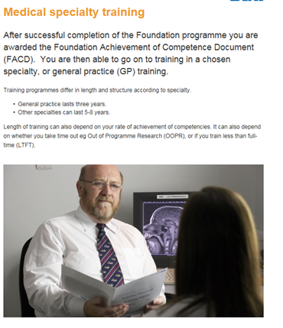
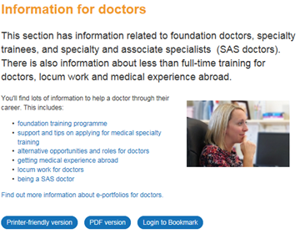
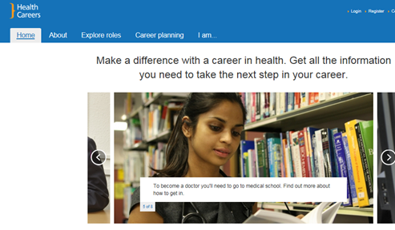
Careers
Careers support and resources available in your trust/webinars
Four stage approach to career management – see https://london.hee.nhs.uk/careers-unit
Group teaching about careers
Also information in fortnightly bulletin
www.healthcareers.nhs.uk for further ideas
Notes:
www.healthcareers.nhs.uk is the national careers website. Please mention what is available locally for your foundation doctors.

